Slide 1
/tmp/PreviewPasteboardItems/DSC00725.JPG
Sustainability Through Hazard Anticipation And Mitigation
Peter J Webster
School of Earth & Atmospheric Sciences, Georgia Institute of Technology, Atlanta GA, USA

Slide 2
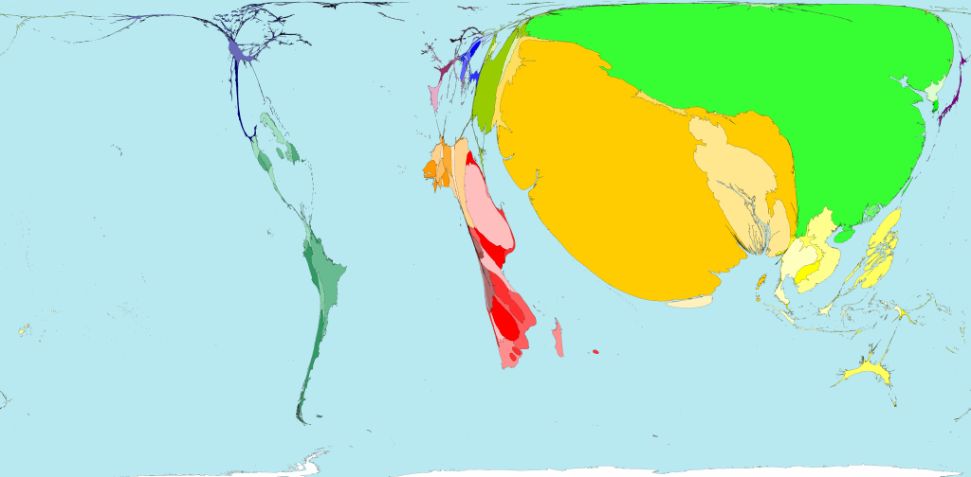
Population affected by Environmental Hazards
“EVENT” WEIGHTED WORLD MAP
Tropical cyclones
Floods (flash and slow-rise)
Earthquakes …
P
C
I
B
M/V
P
South and East Asia (especially India, China and Bangladesh) are most affected by environmental hazards
Source: Milennium Ecosystem Assessment

Slide 3
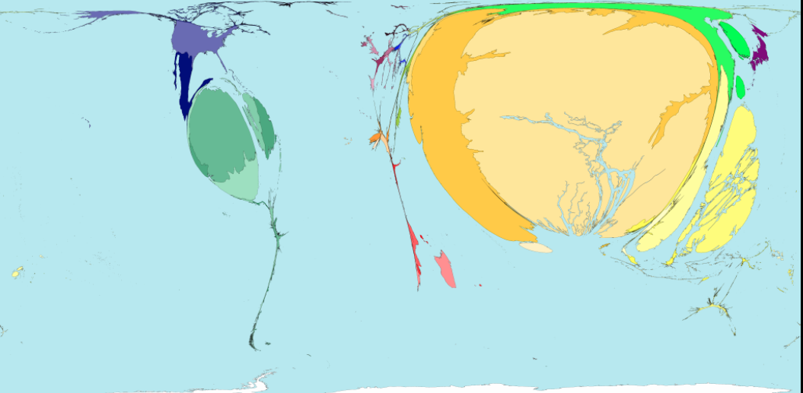
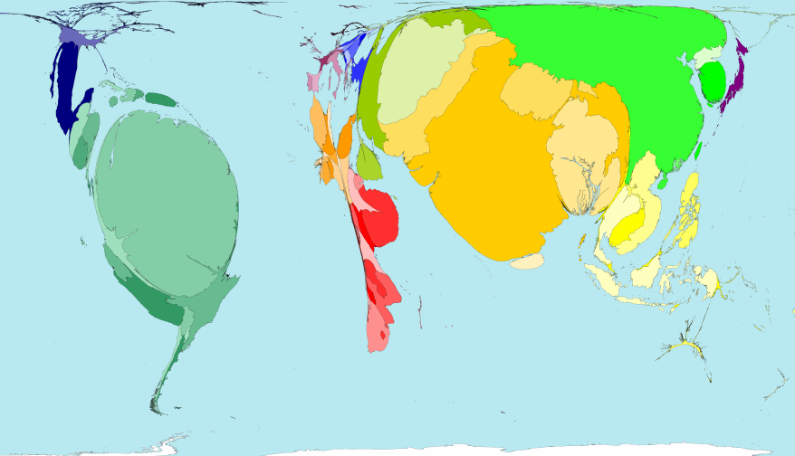
Flood Mortality
Population effected by tropical storms
(5% storms, 95% damage and mortality
B
I
Ch
C
P
I
B
B
P
Ch
P
I
B
Bz
Source: Milennium Ecosystem Assessment

Slide 4
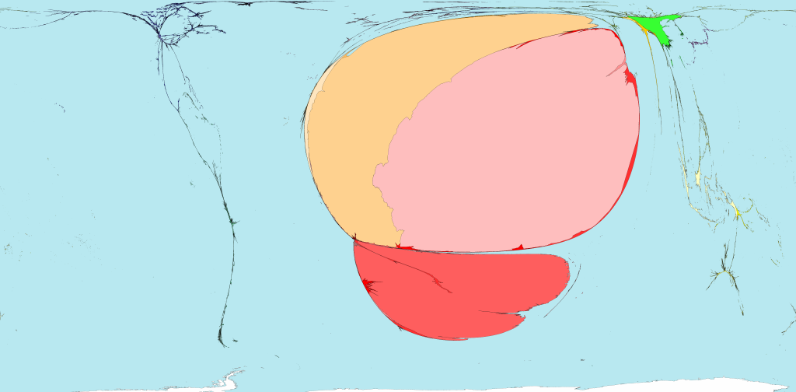
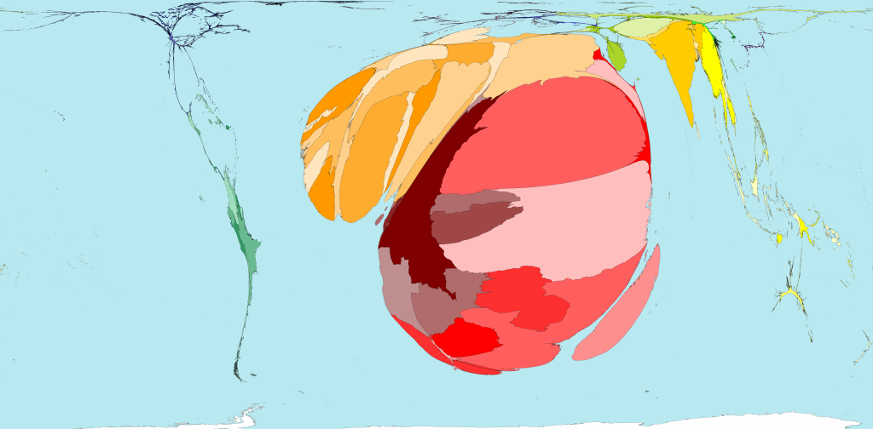
Killed by drought (slow hazard)
Malaria mortality
Africa
Pakistan/India
Africa

Slide 5
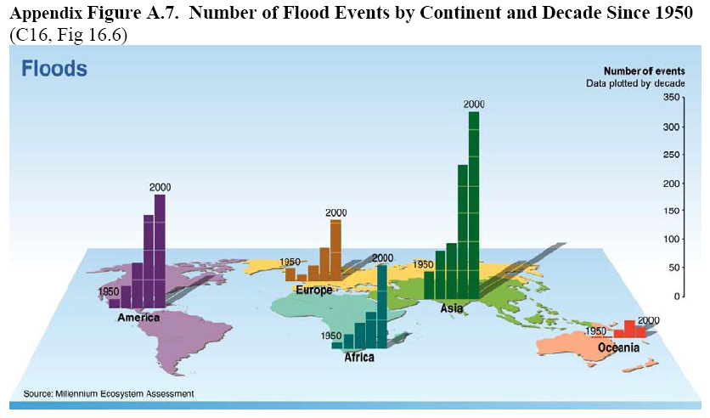
Floods in Asia factor of 2 greater than any other continent
Growing at a rapid rate

Slide 6
PROBABILITY OF INCREASES 10-DAYDURATION
FLOODING IN THE GANGES AND THE BRAHMAPUTRA
Currently, Bangladesh and India, can expect devastating 10-day flooding occurring four times per generation
By the end of the current century there is a high probability that India and Bangladesh will be visited by prolonged floods 10-20 times per generation
GHG
projections
2000 level GHG
Webster and Jian (2011)

Slide 7
PROBABILITY OF INCREASES 10-DAYDURATION
FLOODING IN THE GANGES AND THE BRAHMAPUTRA
Currently, Bangladesh and India, can expect devastating 10-day flooding occurring four times per generation
By the end of the current century there is a high probability that India and Bangladesh will be visited by prolonged floods 10-20 times per generation
GHG
projections
2000 level GHG
Webster and Jian (2011)

Slide 8
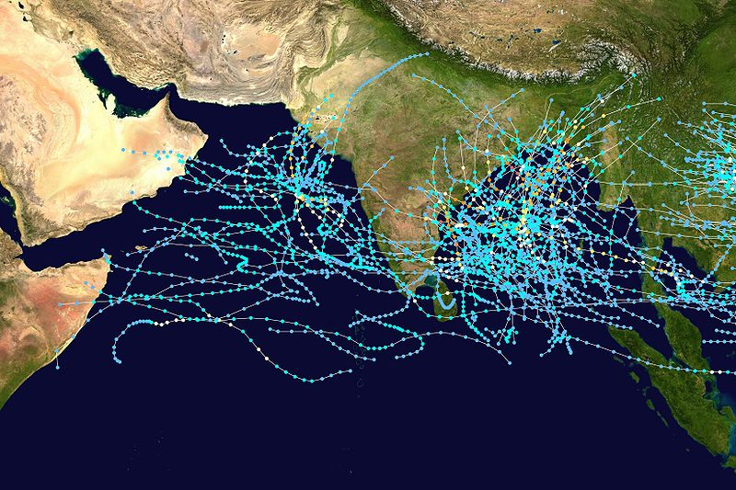
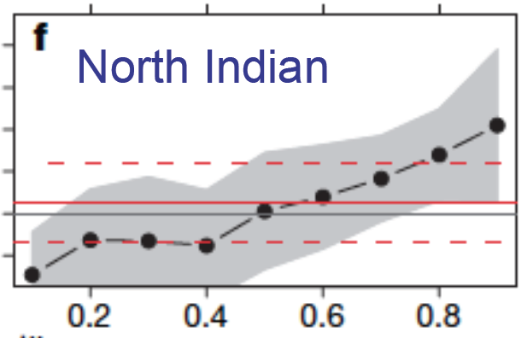
Climatology and Intensity Trends of North IndianOcean
Tropical Cyclones
5% of storms form in NIO (4% BoB. 1% AS)
Two major formation periods: April-May and Oct-Nov
Two major formation regions: Bay of Bengal and Arabian Sea.
1980-2005
Trend in the number of Category 4 & 5 TCs
Cat 4
1981-2006 shows a substantial trend in the number of Category 4 and 5 tropical cyclones.
Only the North Atlantic shows similar growth in intensity (Elsner et al. 2008)
8

Slide 9
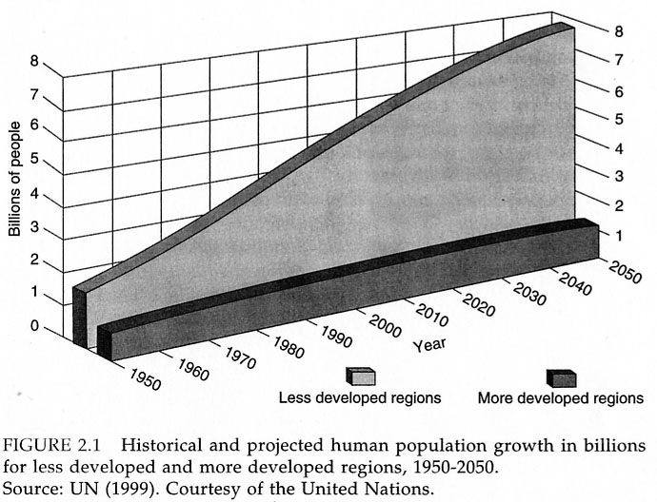
Population increases rapid but mainly in the developing world
Thus, overall percentage of the world in poverty grows
less developed
More developed

Slide 10
Projection: 2025
Population in monsoon countries shaded
 | 1950 | 1995 | 2025
1 | China | China | India
2 | India | India | China
3 | USA | USA | Pakistan
4 | Russia | Indonesia | USA
5 | Japan | Brazil | Nigeria
6 | Indonesia | Russia | Indonesia
7 | Germany | Pakistan | Brazil
8 | Brazil | Japan | Bangladesh
9 | UK | Bangladesh | Ethiopia
10 | Italy | Nigeria | Iran
Global population dominated by Asian monsoon countries in 2025

Slide 11
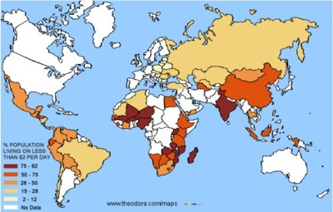
Indelible correlation: Hazards &Income < $2/day
75-92%
50-75
25-50
15-25
2-15
No data
Governments, agencies and NGOs are aware of the poverty-hazard nexus.
Why haven’t hazards been tackled more effectively?
Why has aid been ineffective?
Increasing # hazards with rapidly growing popuaation? Peculiar resistance
The Valley of Death!

Slide 12
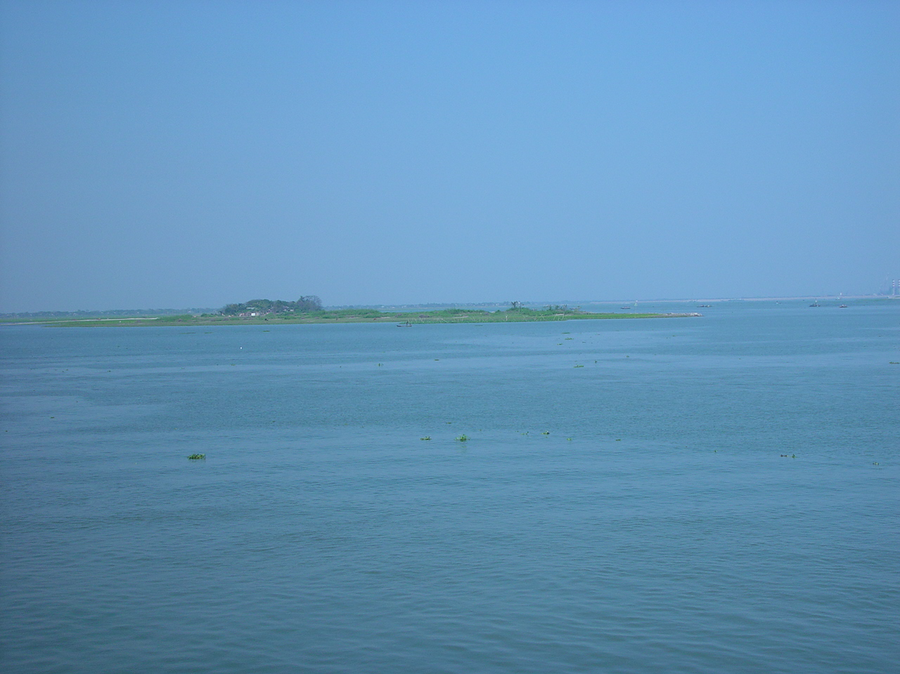
Hazards and the treadmill of poverty
Flooding is the greatest cause of death and destruction in the developing world (e.g., India 6 million ha inundated, affecting 35-40 million people each year)
Governments have made progress in saving lives, but the victims of these slow-onset floods/tropical cyclones remain relentlessly impoverished
Loss of agricultural inputs (seed, fertilizer, pesticides, equipment) exceeds $1B/year in India alone. These agricultural inputs are almost always purchased on credit by smallholders against repayment after an expected harvest
The loss of a crop (or animals) and the agricultural input typically puts the farmer in debt for several years by which time the cycle is repeated, condemning generations to lives of poverty

Slide 15
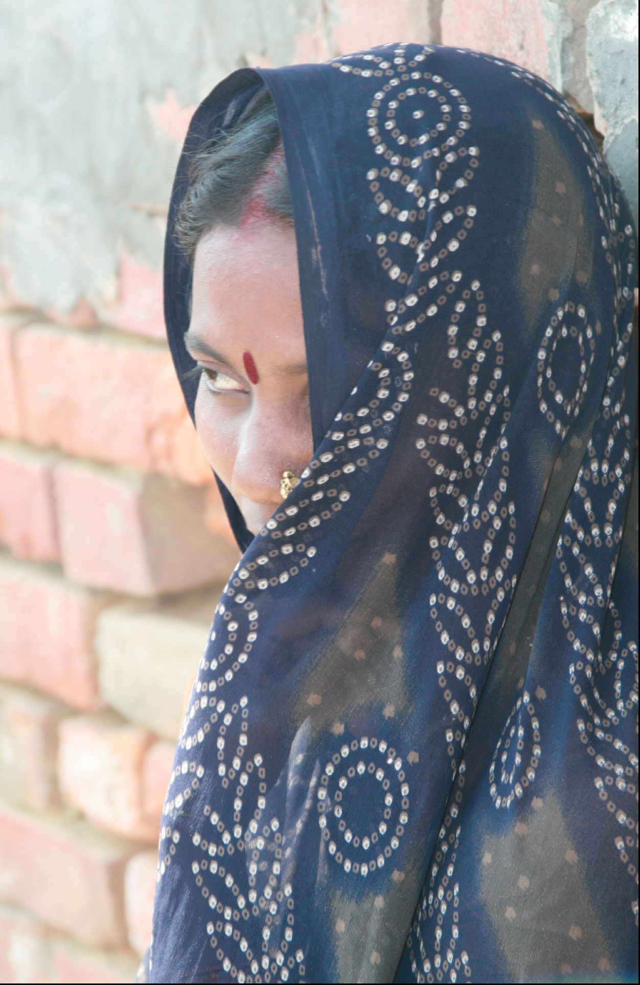

Slide 16
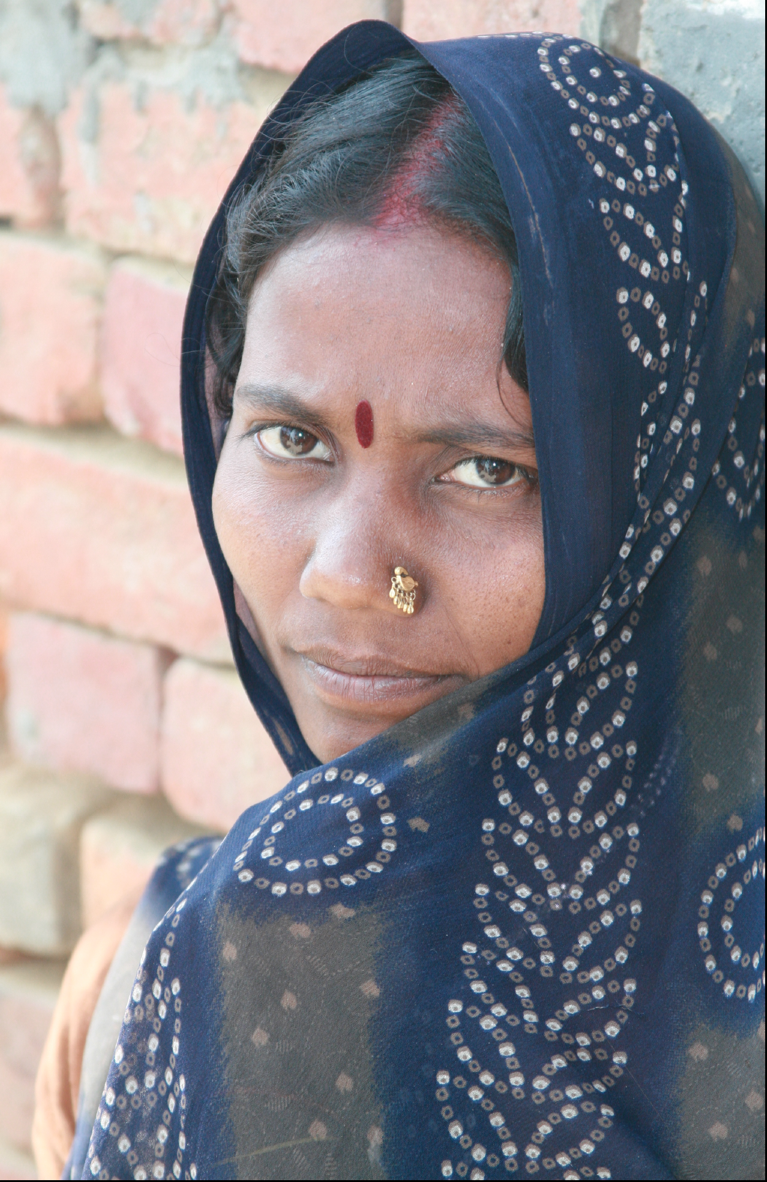

Slide 17
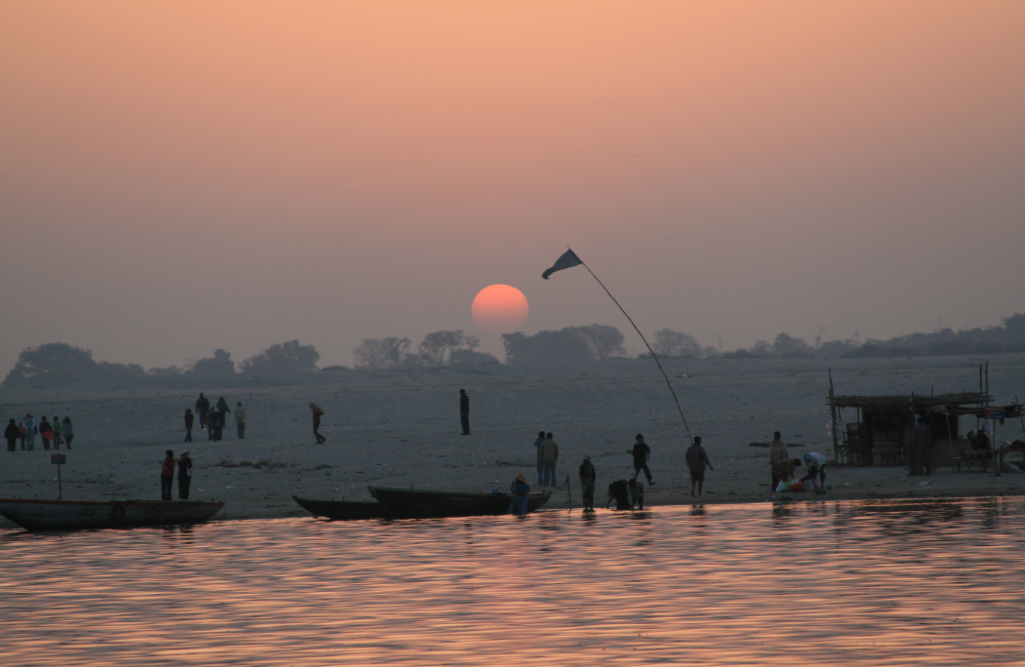
Thank you

Slide 18
Uncertainty in the success of less-developed world “sustainability projects”
100’s of efforts by funding agencies (most from developed world)
Some questions, given a particular project:
Very few are successful (most fall into the Valley of Death)
Will the grapes produce wine?
What type of wine will be produced?
Will the grapes just wither on the vine

Slide 19
So we know what the problems are, we understand the science but how to cross the bridge between science and application
?
?
?
?
BASIC RESEARCH
INNOVATION
INVENTION
Potential Solutions
failure
failure
APPLICATION:
Determination of Risk
Preparation
Adaptation to and mitigation of hazards
failure
WHY DO SO MANY PROJECTS WITHER ON THE VINE?
VALLEY OF DEATH
where so many projects languish and perish

Slide 20
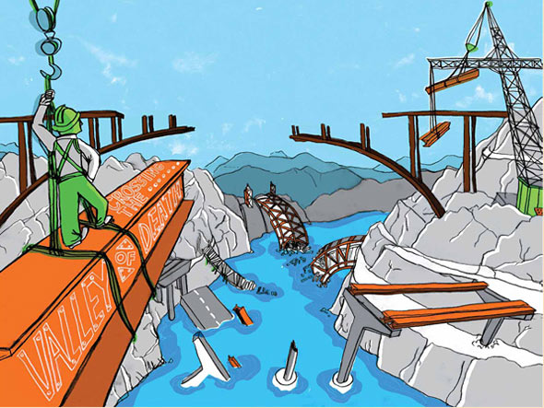
WHY DO SO MANY WELL-INTENTIONED PROJECTS END IN FAILURE?
Valley of Death
Clearly, we know the science that will provide a populace of the probability of an impending hazard and we have a basic idea of how to communicate this knowledge, but, …
why is there so much trouble in going from basic research to application?

Slide 21
WHY SO MANY DEVELOPMENT GRAPES DRY ON THE VINE
Developed world solutions for less-developed world application
Valley of Death
No human capacity building: loss of young scientists/technicians
Lack of maintenance: 3-year grants and political changes of mind
Imposed solutions rather than partnerships
Technological transfer
National pride and resentment

Slide 22
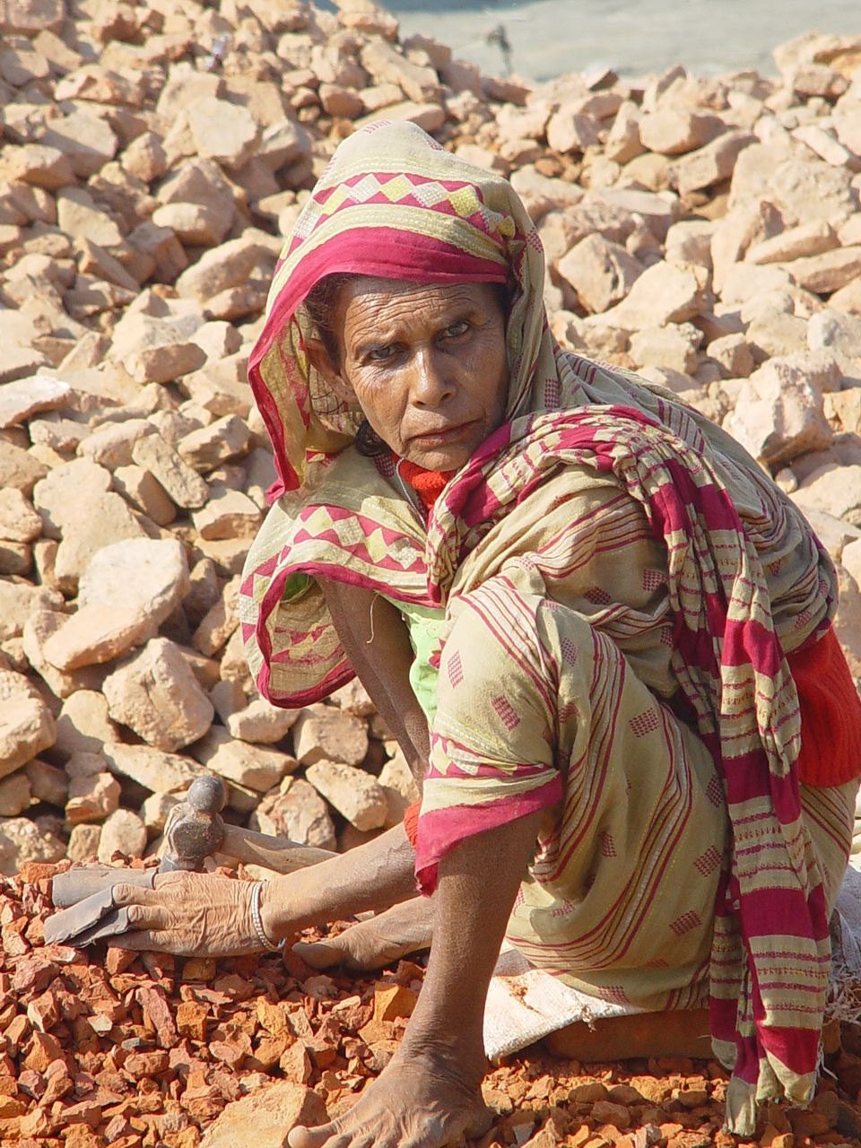
Sustainability through Hazard Anticipation
and Mitigation
(SHAZAM)
We are firmly of the belief that:
“….A society that learns to deal with present era hazards will be best equipped to adapt to and mitigate hazards encountered in a changing climate…”
And altering a
“transcribed expectation (born to suffer) to a desired future”
SHAZAM is an onomatopoeia for “rolling thunder”:

Slide 23
OVERVIEW
The spiral of environmental hazards: hazards, population => poverty => ……..
End-to-end prediction systems and spanning the “valley of death”.
Targeted environmental probabilistic forecasting
Providing forecasts directly to those who need and can use them
Four examples:
Ways ahead and spanning the “valley of death”.
Flood forecasting systems in Bangladesh
Flooding forecasting systems Pakistan
Gujarat heat stress and public health (JH)
Public health in a changing climate (JH)

Slide 24
End-to-end flood prediction in Bangladesh: Extended probabilistic flood forecasts on medium and long time-scales Results after 10 years: Considerable drying of the grapes on the vine. Not exactly a good shiraz but perhaps a moderate amarone!

Slide 25
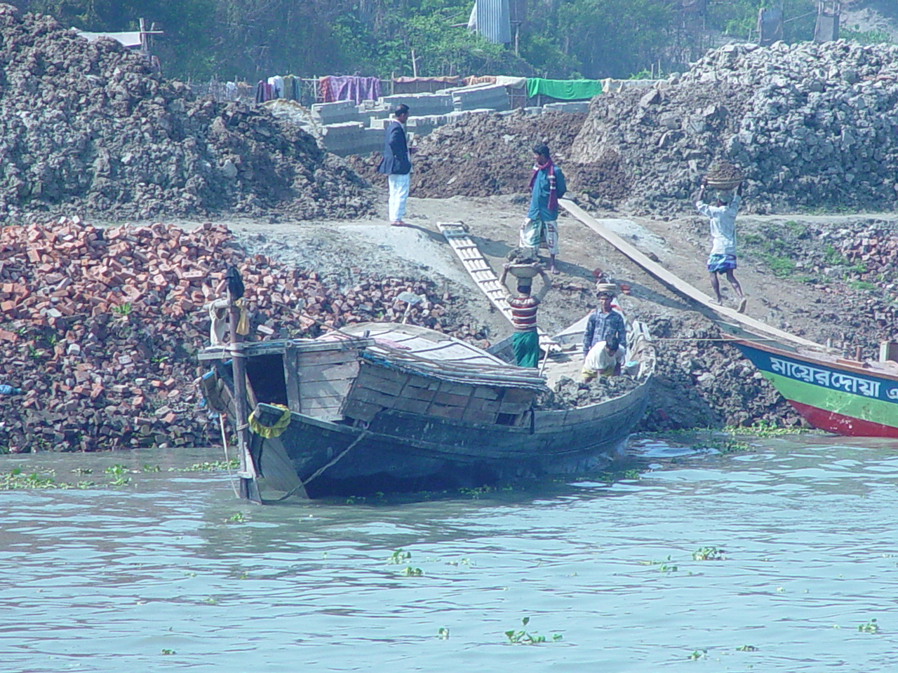
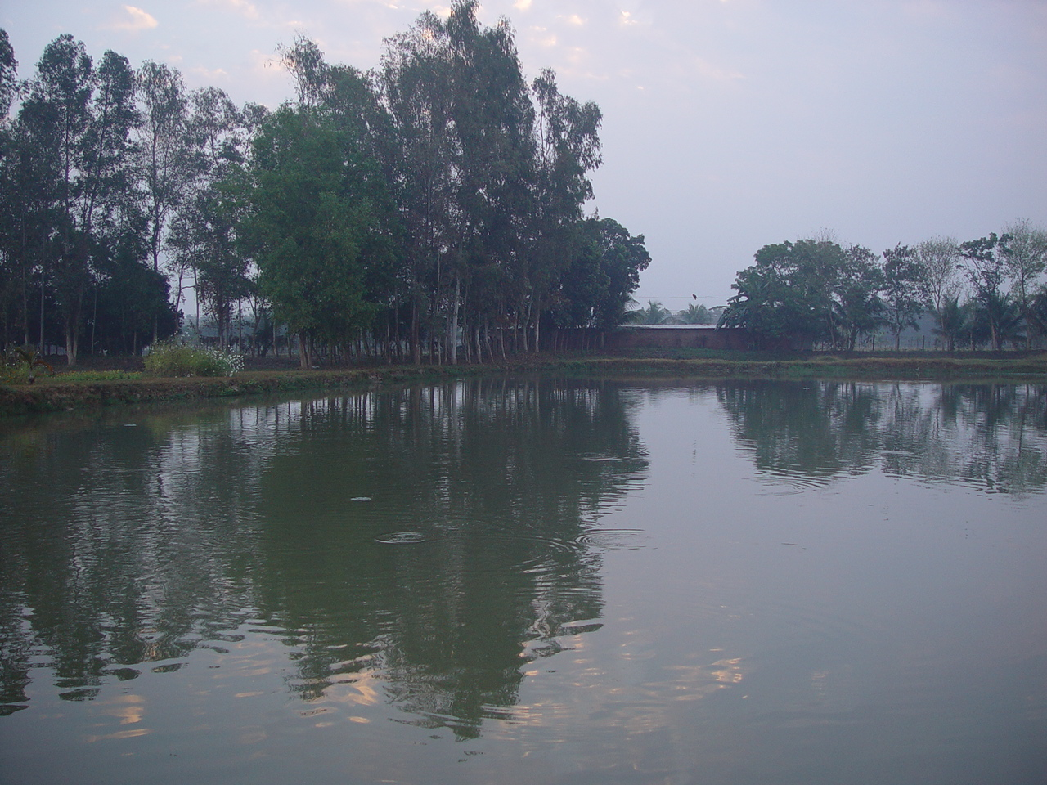
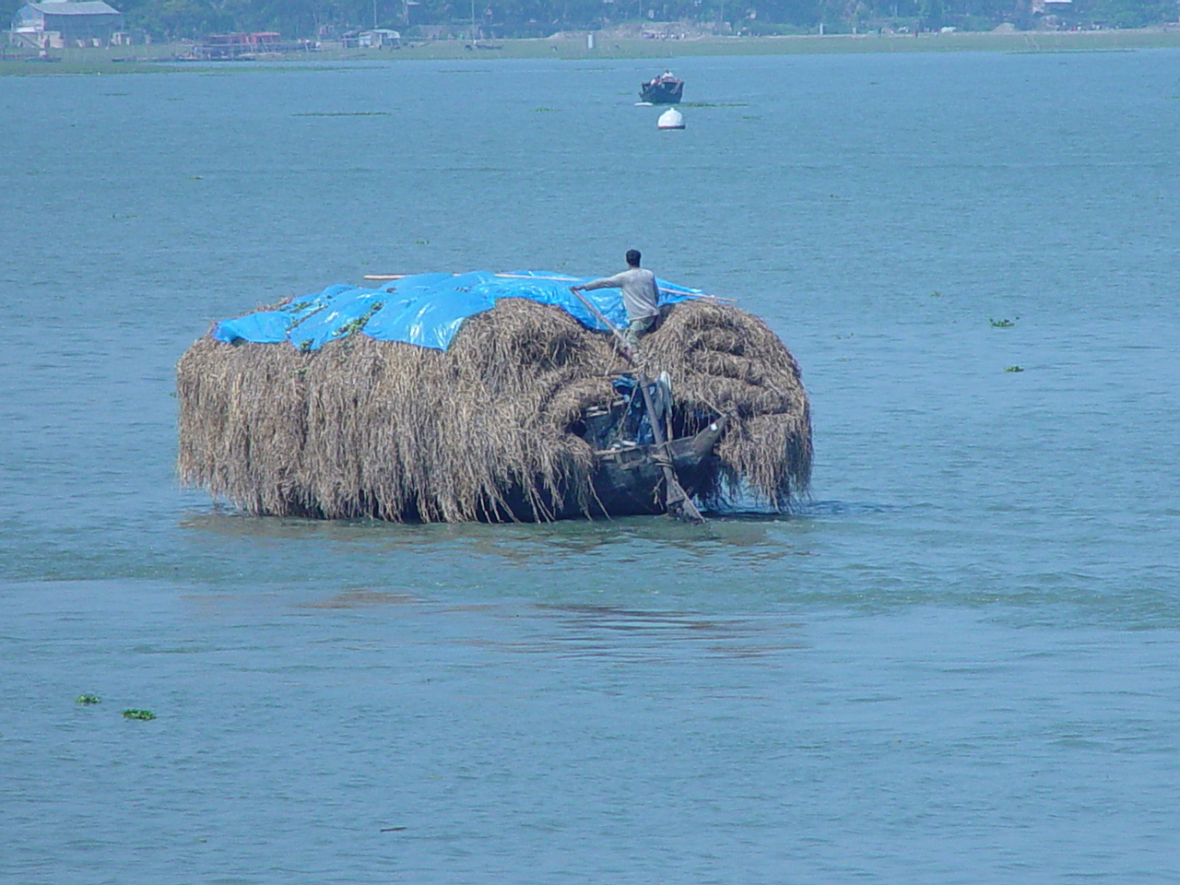
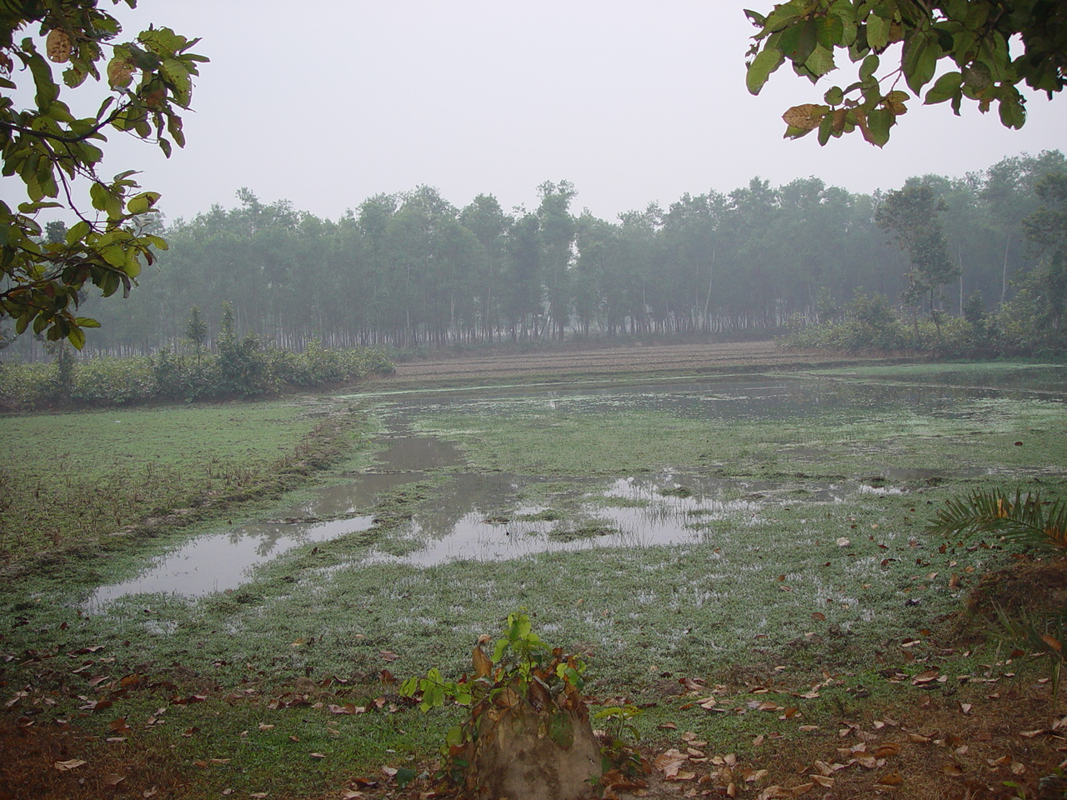
water as a resource

Slide 26
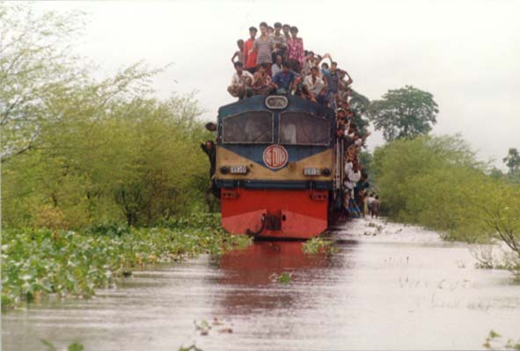
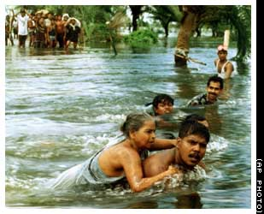
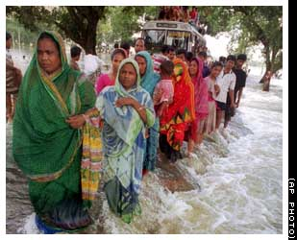
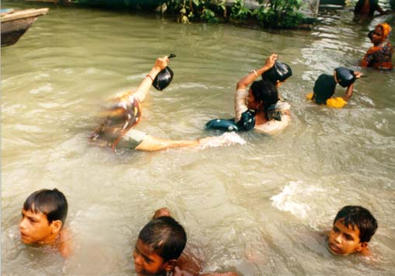
water as a hazard………

Slide 27
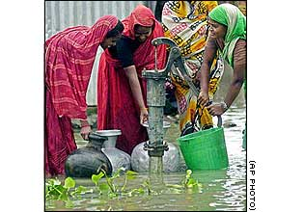
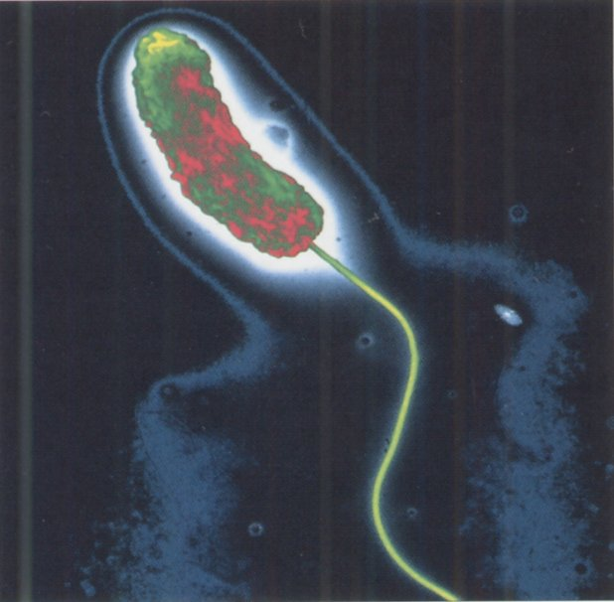
water as a hazard

Slide 28
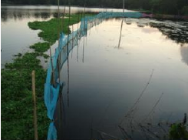
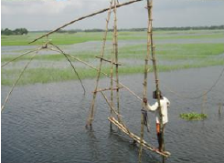
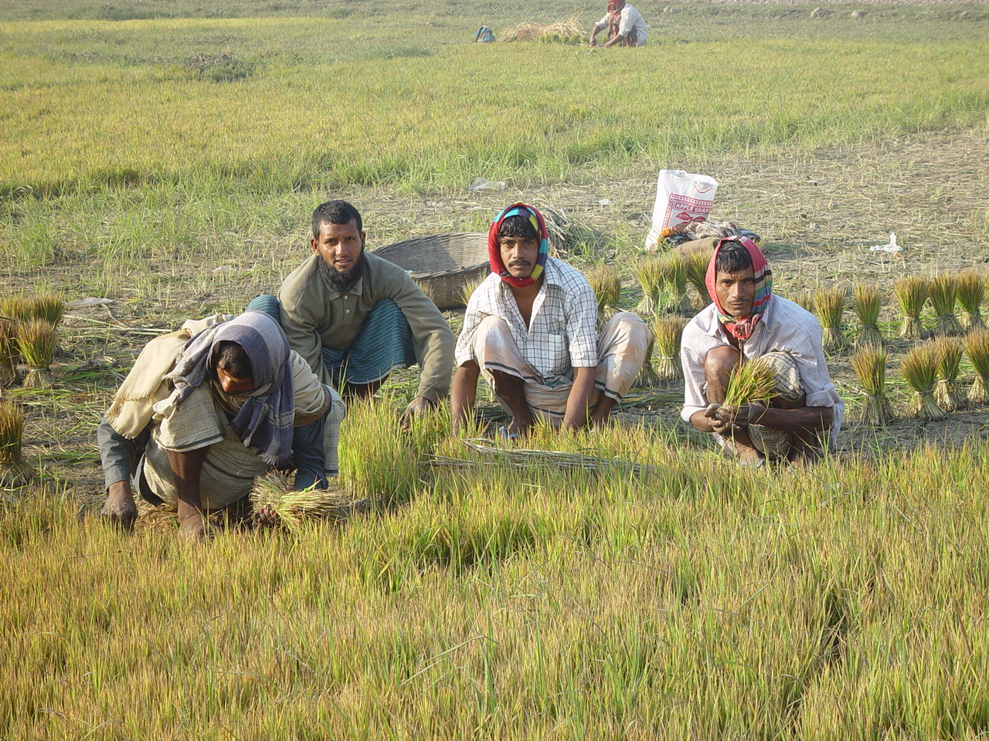
The Bangladesh Project
Following the disastrous 1998 flooding in Bangladesh when flooding from the Ganges, Meghna & Brahmaputra covered 60% of Bangladesh for 3 months, we were approached to design an advanced flood warning system.
Bangladesh, like India today, had only a 2-day river forecast horizon
CFAN produces probabilistic flood forecasts for the Govt of Bangladesh to 1-15 days, 15-30 days and seasonal since 2004; tropical cyclone forecasts since 2007.

Slide 29
In 2001, we embarked on the project to provide probabilistic forecasts to the people of Bangladesh regarding the onset, duration and severity of floods. The idea was:
to reduce the incline of the seemingly endless treadmill of poverty by the risk management of extreme events and the increase of agricultural yield

Slide 30
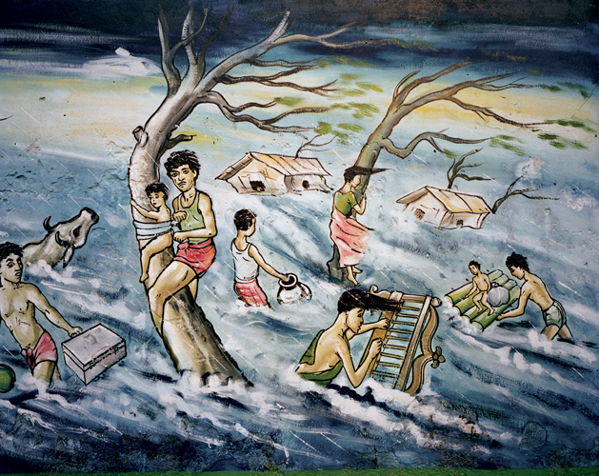
How to change: “watch, work, wait and worry”
into orderly planning to prepare and mitigate the impacts of flooding and other hazards.

Slide 31
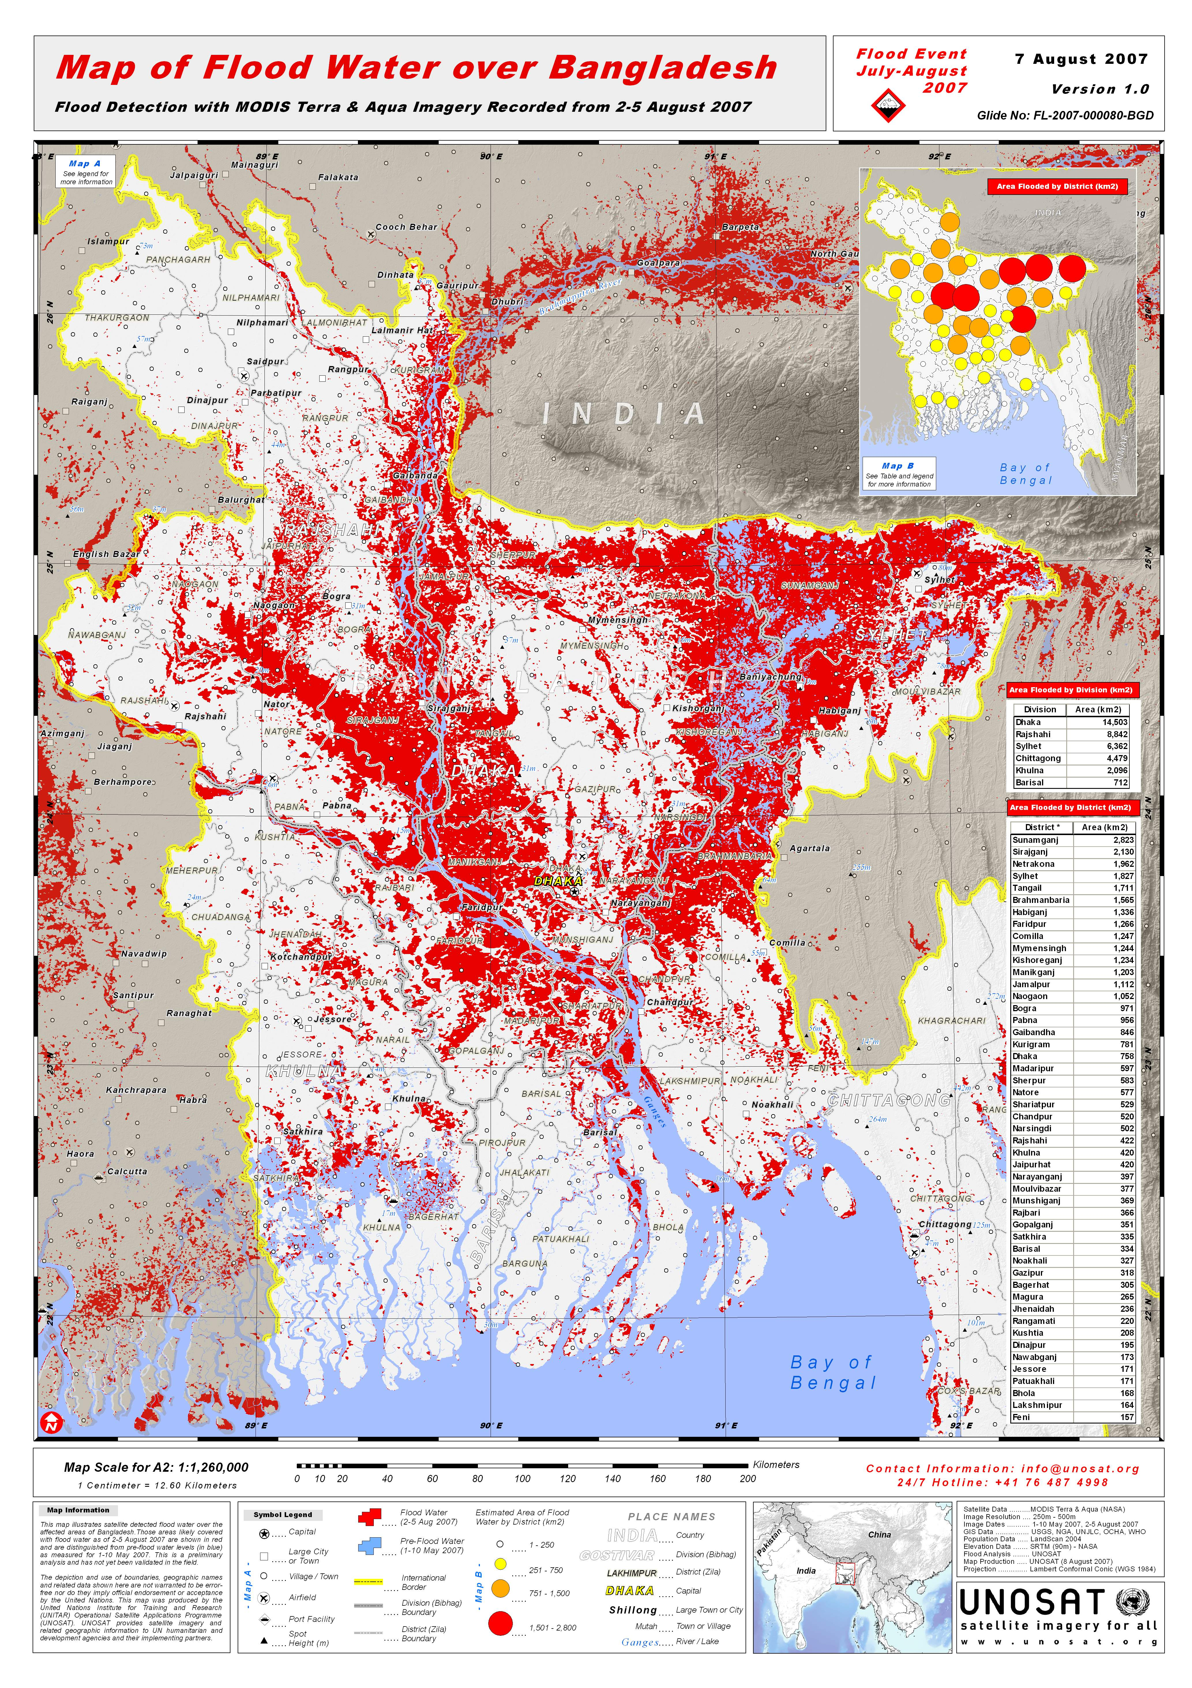
Forecasts had to be made with NO cross-border data form India. This is a “fact of life” in hydrology
Strategy was to “synthesize” river flow probability data using rainfall predictions form ECMWF
Some hope that satellite data will provide added information in the future

Slide 32
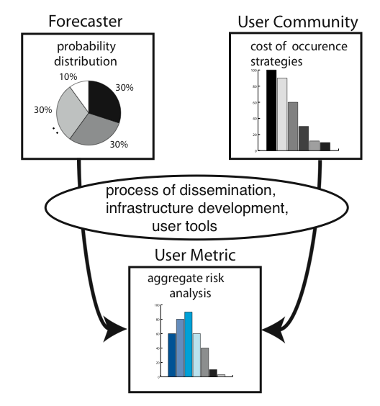
Combining probabilities with specific problems
to develop a measure of aggregate risk
RENDERING THE FORECAST USEFUL
Quantitative
information
from the
user community
Probabilities of the occurrence an event determined by ensemble of ECMWF forecasts
Costs of occurrence strategies (or losses) to mitigate impacts: Determined by user communities
Probabilities and costs of occurrence combine to produce an aggregate risk
User community makes decisions based on risk assessment
Combination of probabilistic forecasts of system plus user information produces easy to understand aggregate risk analysis for decision making
Risk = cost x probability

Slide 33
Components and Contributions
RENDERING THE FORECAST USEFUL
Quantitative
information
from the
user community
Use of ensemble forecasts from international centers (ECMWF) to hazards modules (TC, flood…)
Government agencies, local authorities, farmers, agricultural extension services
Use
Risk establishment by governments, user communities, individuals

Slide 34
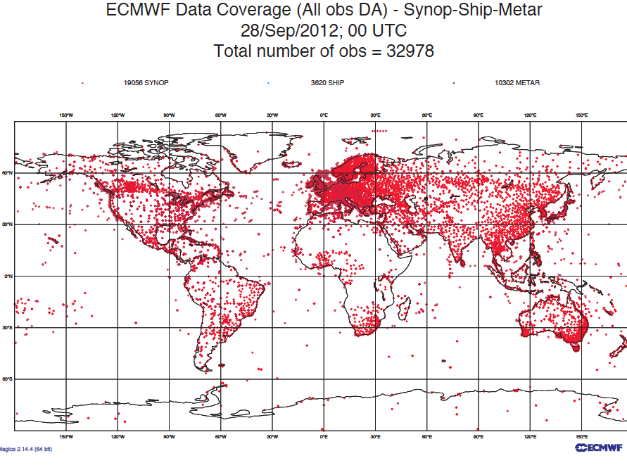
Why international efforts for determination of hazard probabilities?
RENDERING THE FORECAST USEFUL
Forecasts beyond 2 days require broad domain forecasts and ingestion of vast amounts of data
Global forecast models have taken decades to develop and extensive computer facilities (billions of $)
Beyond development of most countries, developed/less-developed
Use

Slide 35
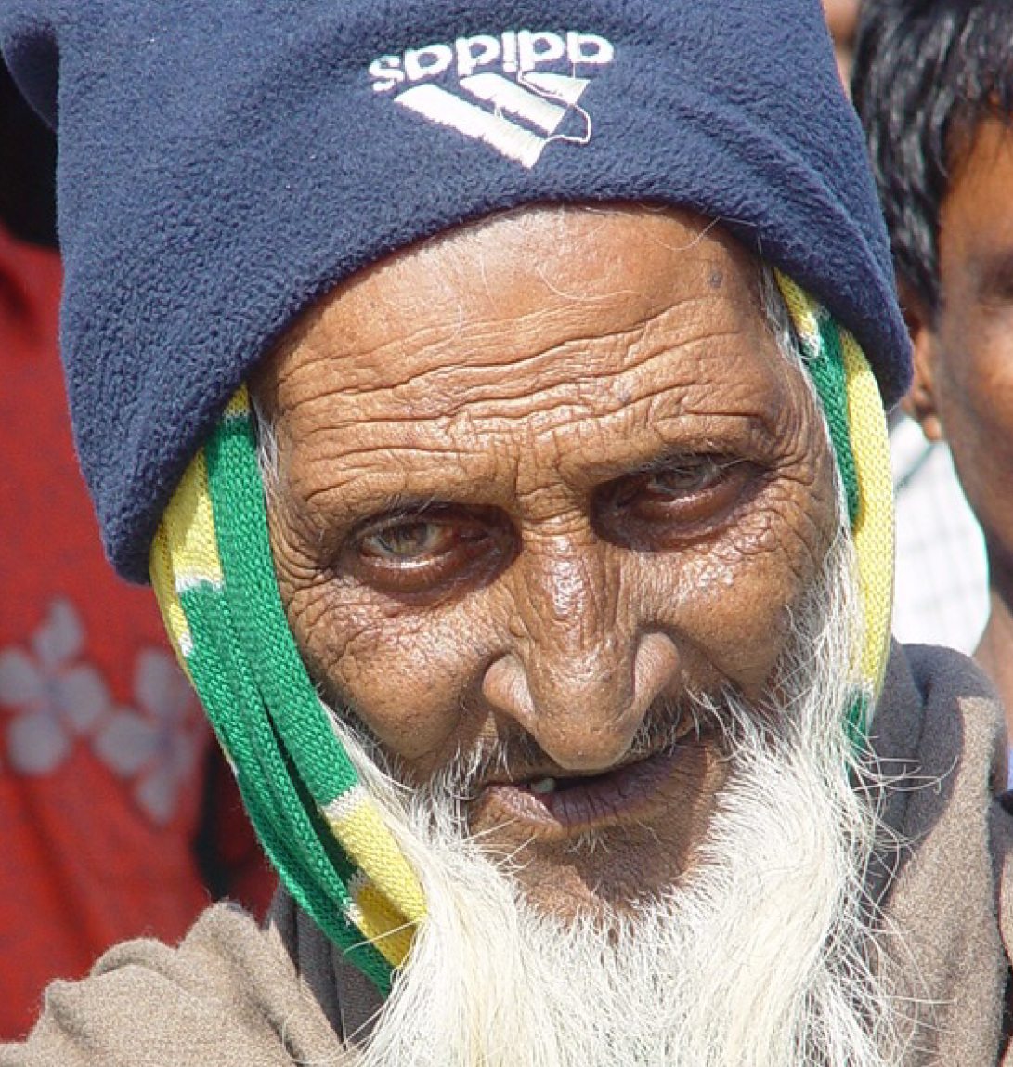
Probabilistic forecasting and the developing world:
A conversation (January 2003)
CFAB: We hope to provide you with seasonal forecasts to help you plan your agricultural activities
FARMER: That would be good.
CFAB: But we will not always be correct: Perhaps 7 times out of 10.
FARMER: (after some thought): That is fine! Only God knows 100% what will happen, and he is not telling and you are not God!
Right now, we guess each year and that means we are right as often as wrong.
70% means I am ahead!

Slide 36
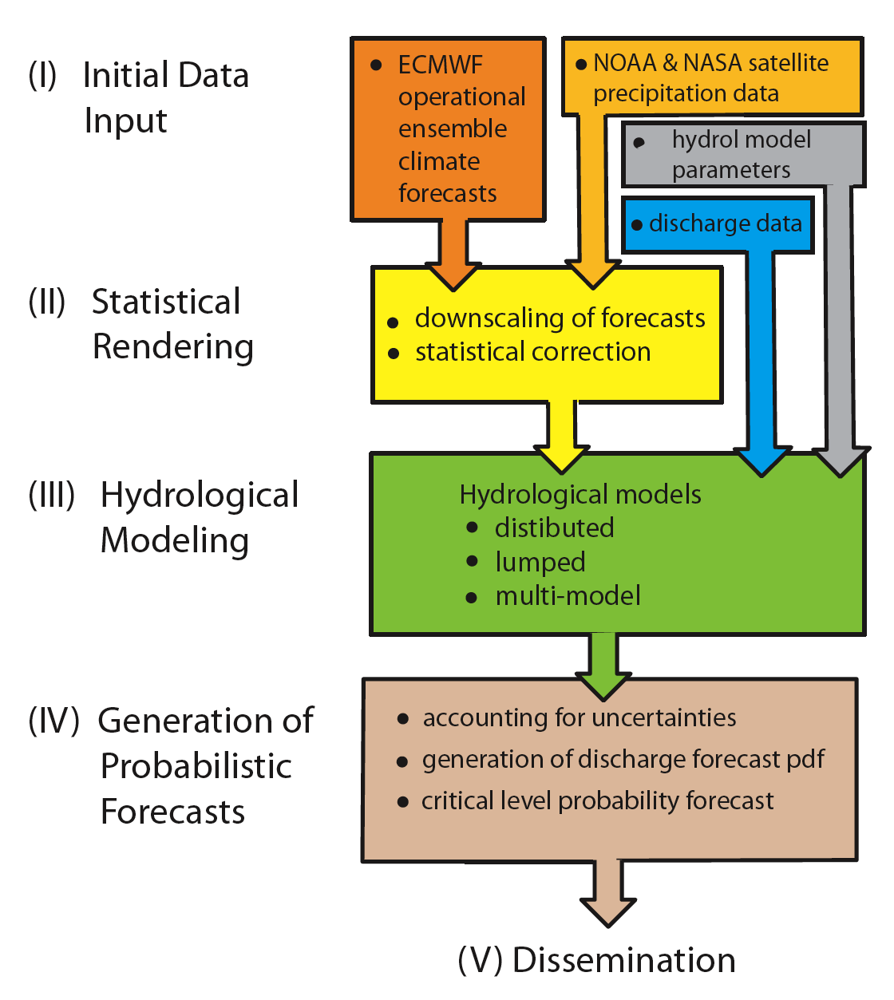
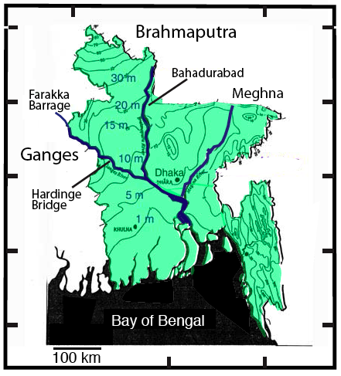
Flood Forecasting System
Hopson and Webster (2010)
Webster et al (2010)
Webster and Jian (2011)

Slide 37
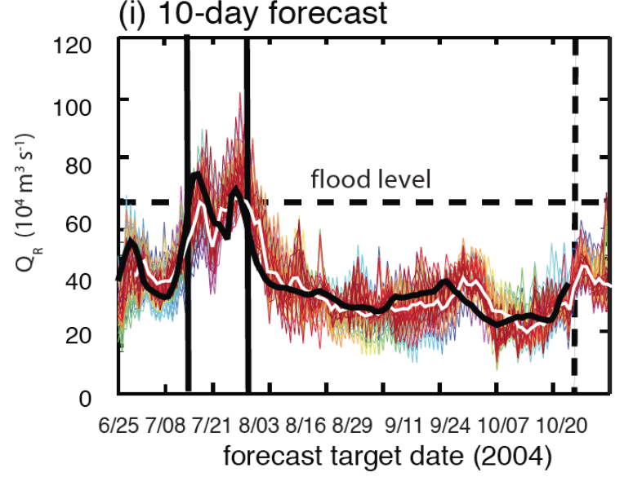
Explanation of the forecasts
Summary of 2004 10-day Brahmaputra forecasts
Period of flooding
Observed flow (retrospective)
Ensemble mean (white)
Spread of the ensemble members from which probability of flooding determined

Slide 38
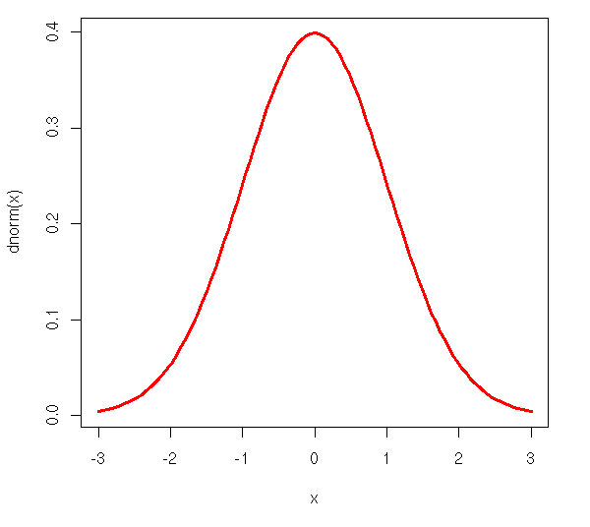
Why bother with multiple ensembles?
Forecasts made here
For here
10-day forecast made July 08 for July 17, 2004
flood level
“a”
“b”
Probability of exceeding flood level 10-days in advance calculated from ensemble spread
verification
Two ensembles may give forecast “a” (no flood) or “b” (strong flood) Need many realizations to determine probability of river discharge and calculate risk

Slide 39
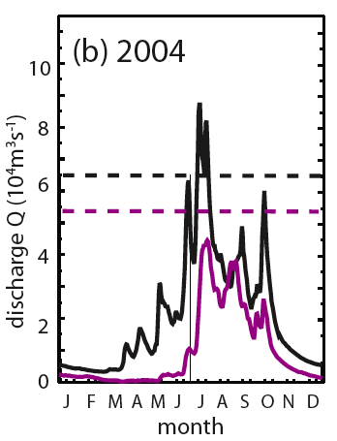
2004 real time 10-day forecasts of the Brahmaputra
B
No flooding of Ganges
Early Brahmaputra flooding with double peak
G

Slide 40
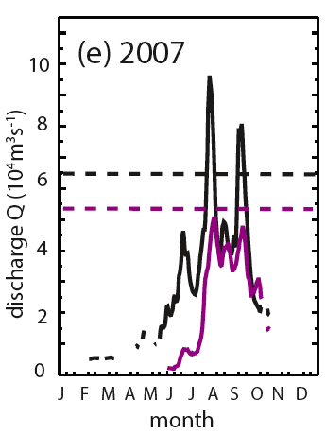
2007 real time 10-day forecasts of the Brahmaputra
No flooding of Ganges. None forecast
Both Brahmaputra peaks predicted and also the duration of each flooding event
Forecasts used for mitigation efforts in pilot studies

Slide 41
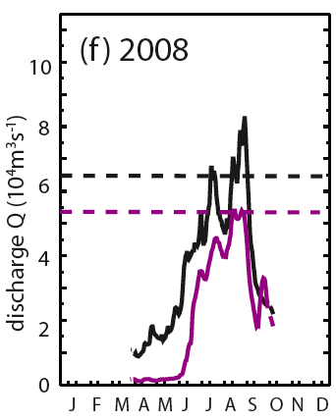
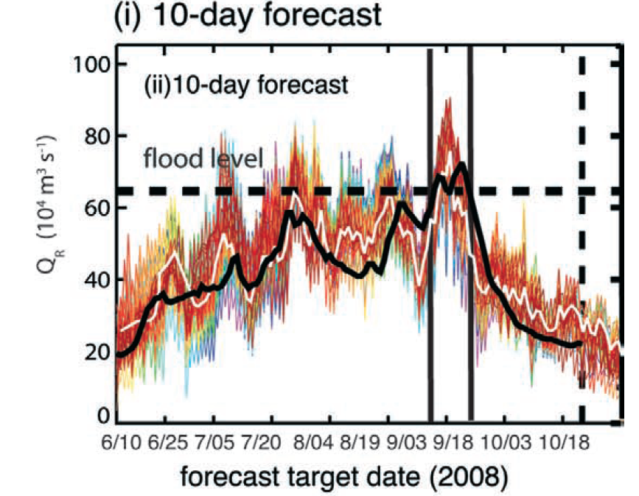
2008 real time 10-day forecasts of the Brahmaputra
No flooding of Ganges: no false positives although heightened probabilities August
Brahmaputra flooding well predicted
Forecasts used for mitigation efforts
Detail of forecast plumes

Slide 42
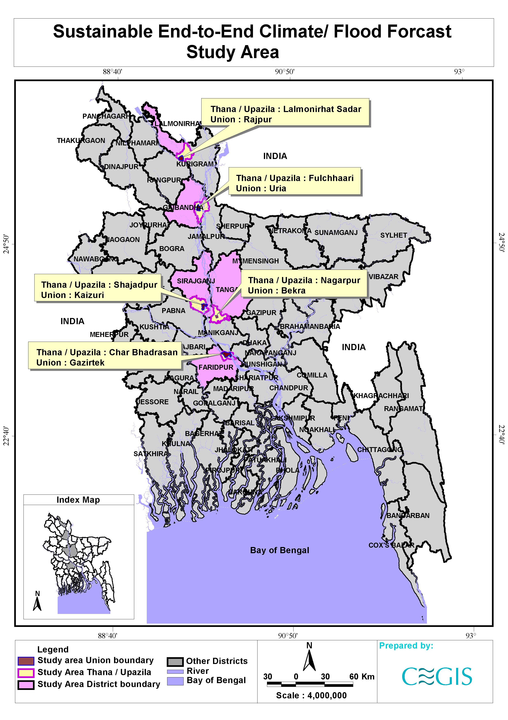
During 2007 and 2008, the forecasts were used operationally in Bangladesh.
A number of areas were designated as test regions and the forecasts transmitted (via cell phone) to district leaders and from there to the village level.
Prior training was instigated for evacuation, livestock safety, early harvest, safe drinking water ahead of high probability forecast of floods

Slide 43
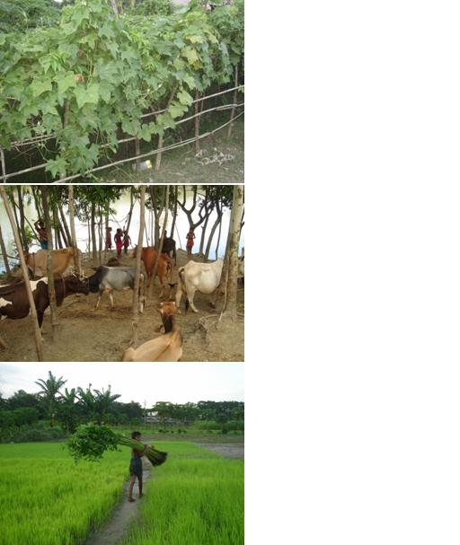
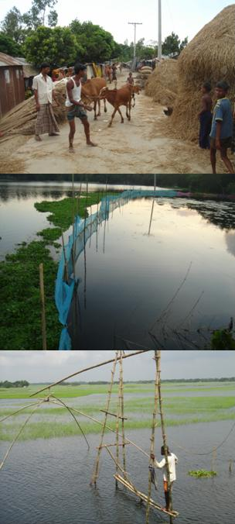
The 2007-2008 pilot studies in Bangladesh
Prior to evacuations ahead of the 3 flooding events,
a large number of actions were taken:
Early harvesting
Transplanting
Cattle to safe refuge
Fish pond reinforcement
Water and food storage
Household and agricultural effects to safety
Seeds/seedlings moved to safe locations

Slide 44
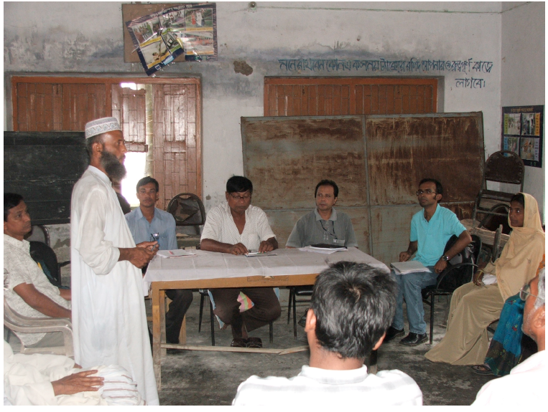
Statement 2008:
Imam from the Mosquein Koijuri Union of Sirajgong District in Bangladesh pilot studies: CEGIS (Bangladesh) and ADPC
"We disseminate the forecast information and how to read the flag and flood pillar to understand the risk during the prayer time. In my field, T. Aman was at seedling and transplanting stage, I used the flood forecast information for harvesting crops and making decision for seedling and transplantation of T. Aman. Also we saved household assets.”
Savings/flood event*:
Fisheries: $130
Agriculture: $190
Livestock: $500/animal
Household: $270
(*annual income $450/year)

Slide 45
Statement 2008:
Imam from the Mosquein Koijuri Union of Sirajgong District in Bangladesh pilot studies: CEGIS (Bangladesh) and ADPC
"We disseminate the forecast information and how to read the flag and flood pillar to understand the risk during the prayer time. In my field, T. Aman was at seedling and transplanting stage, I used the flood forecast information for harvesting crops and making decision for seedling and transplantation of T. Aman. Also we saved household assets.”
Savings/flood event*:
Fisheries: $130
Agriculture: $190
Livestock: $500/animal
Household: $270
(*annual income $450/year)

Slide 46
The 2007-2008 pilot studies in Bangladesh
7 cattle moved to higher ground ahead of the floods:
10 man-years effort saved.

Slide 47
“World is Flat”* application of science
“……..The particular application of this forecast scheme in Bangladesh represents a “world is flat” approach to emergency management through the collaboration of scientists in Europe (producing the ensemble meteorological and climate forecasts), the U.S. (developing and producing the integrated flood forecasts), and the developing world (integrating the flood forecasts into their disaster management decision-making protocol), all enabled by the high-speed internet…….”
Webster et al. (2010)
* “The World is Flat: A Brief History of the 21st Century. T. L. Friedman, 2005

Slide 48
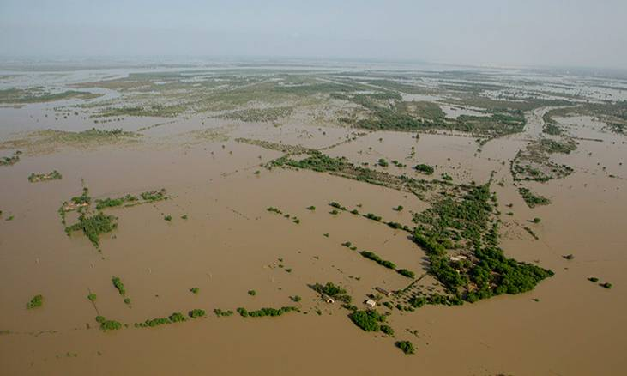
(II) The Pakistan Flood Project
In July-August 2010, August 2011 and September 2012, extensive floods created havoc across Pakistan
In total millions of people were effected and thousands died. Losses have totaled > $40B
Yet, the floods occurred with essentially no warning
In 2010 and 2011 we showed that there was a high probability of intense rainfall across Pakistan 10 days in advance.
In 2012, we developed a new hydrological model (with flood plain capability), forced by ensembles of rainfall forecasts from ECMWF. The evolving September flooding was forecast 10 days in advance.

Slide 49
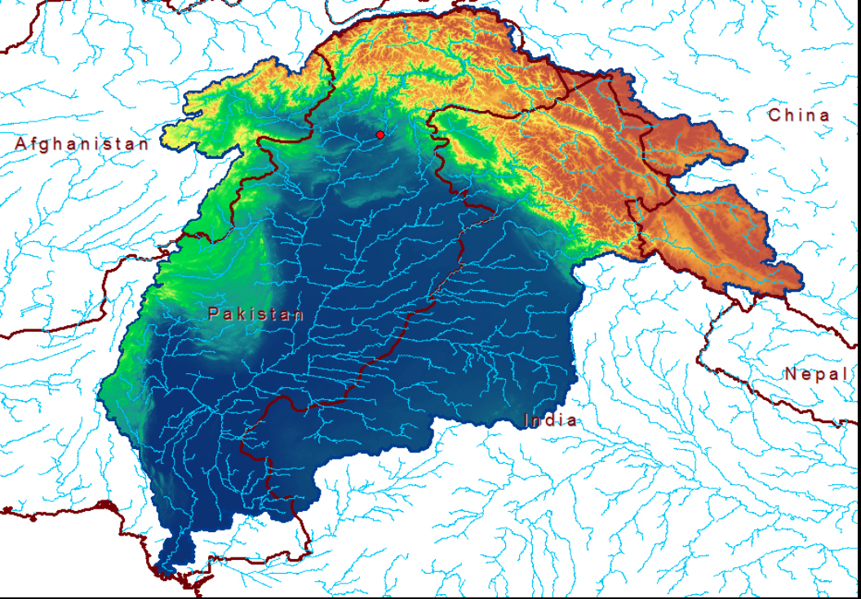
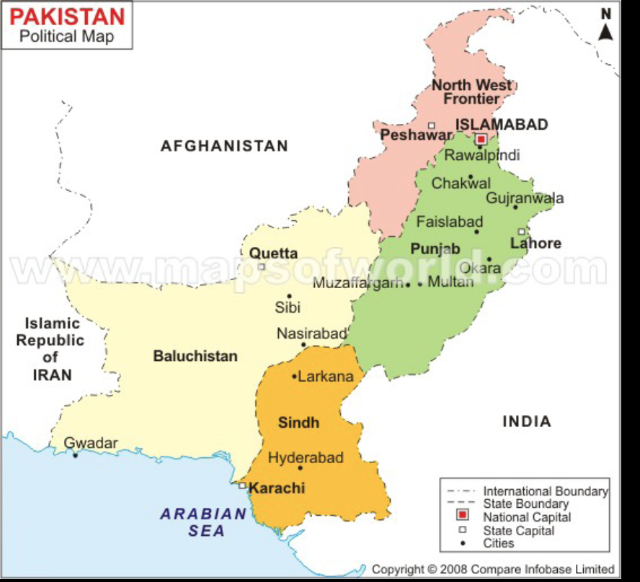
The 0.125º basin and topographic model of Pakistan
Indus main artery
Vast Indus plain
Severe topography north
Trans-boundary streamflow

Slide 50
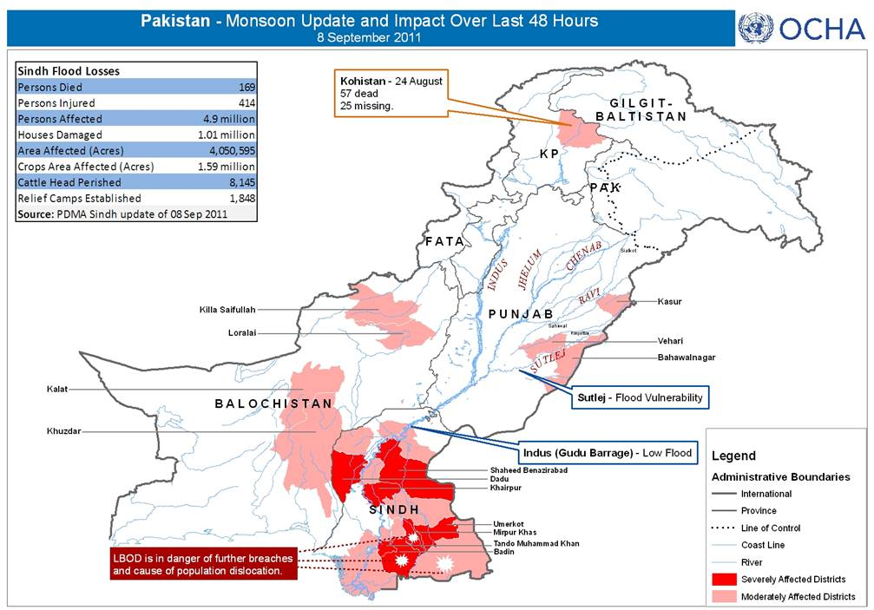
PAN-PAKISTAN FLOOD
JULY-AUGUST 2010
20 million people were affected,
160,000 km² inundated,
2000 mortality
Water borne diseases
Total economic loss: $20-40B
Limited forecast or warning
SINDH FLOODS AUGUST 2011:
500 Dead,
9 million affected,
2 m acre inundated,
2 days warning

Slide 51
Predictability of the 2010 rainfall pulses
Probability that rainfall over northern Pakistan will be 168% of climatology (mean + 1sd) as a function of forecast lead time
Each of the major pulses of rainfall over northern Pakistan was forecast ~10 days in advance (follow white arrow).
Uses statistically rendered ECMWF 1-15 day forecasts
Observed rainfall
*
Webster, Toma and Kim (2011) GRL

Slide 52
Predictability of the 2011 rainfall pulses
Observed rainfall

Slide 53
Predictability of the 2012 rainfall pulses
Observed rainfall
Major Rainfall pulse forecast almost 2 weeks in advance.
The rainfall forecasts were used to run the hydrological model thus producing forecasts of flooding and inundation.

Slide 54
REAL-TIME PROBABILSITIC PAKISTAN FLOOD FORECASTS
SEPTEMBER 3 for SEPTEMBER 4-13
degree of confidence
Flood level
http://cfanb.eas.gatech.edu/HYDRO/hydro.php

Slide 55
Inundation forecast September 07 2012
Inundation forecast September 11 2012
Forecast plumes at the three locations

Slide 56
REAL-TIME PROBABILSITIC PAKISTAN FLOOD FORECASTS
SEPTEMBER 16 for SEPTEMBER 17-26
degree of confidence
Flood level
http://cfanb.eas.gatech.edu/HYDRO/hydro.php

Slide 57
Inundation forecast September 21 2012
Forecast plumes at the three locations
Inundation forecast September 24 2012

Slide 58
Pakistan Flood Project Summary
Forecasts were made without any Pakistan data except for historical calibration at one point
Attempting to enjoin Pakistani authorities to engage in joint flood forecasting project
To span the “valley of death” need to form Pakistan “Hazard Forecasting and Warning Centre” for all hazards. Create career path for young scientists and technicians.
Working with World Bank
http://cfanb.eas.gatech.edu/HYDRO/hydro.php).

Slide 59
(III) Ganges, Brahmaputra and Yangtze river basins in a changing world and a growing population: Floods, the availability of fresh water, avoiding international crises and developing a basis for policy Addressing the longer term problems

Slide 60
Major rivers, fertile deltas
High population density.
Centers of poverty
Multiple environmental hazards (slow rise and flash floods, tropical cyclones, storm surge)
The Third Pole:
In: Indus
G: Ganges
B: Brahmaputra
I: Irrawaddy
M: Mekong
R: Red
J: Jiang
Y: Yangtze
Ye: Yellow
The countries surrounding the Tibetan Plateau, together with much of Africa, are the most societally and environmentally vulnerable regions on the planet

Slide 61
THE 21ST CENTURY
Different ranges of temperature increase depending on scenario
Changes in precipitation (wetter South and East Asia)
Growing population (double by 2100)
Global warming scenarios (pdfs)
Changes in precipitation (2100: ensemble mean)
Population growth

Slide 62
The Conundrum of Responsibility (????)
Carbon production
Mortality

Slide 63
Is it possible to quantify flood and risk & fresh water availability in major river basins in the 21st Century?
Use IPPC AR4 coupled climate models of 20th and 21st centuries
Use hydrological model described earlier
Eliminate models that do not have realistic monsoon annual cycle
Use ensembles of these models to determine probabilities of flood of various durations
Determine probability of fresh water availability

Slide 64
20th and 21st modelled discharge
In all scenarios (except the constant CO2 commit) there is a high probability of river discharge increase and increased variability

Slide 65
PROBABILITY OF INCREASES OF 5 AND 10-DAY FLOODING
IN THE GANGES AND THE BRAHMAPUTRA
Probability of major flooding increases by factors of 2-3.
Return period of floods decreases by at least factor of 2.

Slide 66
Despite probability of increase in flooding, fresh water availability in all three basins equilibrates or slightly increases due to overall greater discharge.
Yangtze
Ganges
Brahmaputra

Slide 67
Troubles at the Third Pole
Large water management projects have created social, ecological, and economic problems, the repercussions of which cannot be immediately gauged.
China has initiated massive infrastructural projects in Tibet, where many major Asian rivers originate.
Industrialization upstream in China has led to soil erosion, deforestation, and landslides, whose impacts are felt in the lower riparian states of Bangladesh and India.
That these countries are part of a common ecosystem was made tragically clear by the flash floods that ravaged northeast India in 2000 caused by a landslide in Tibet.
Sane future progress can only be made through international cooperation based on assessments of probabilities of environmental and population changes
and then…..

Slide 68
India plans the diversion of the Ganges and Brahmaputra (and other rivers) to allow irrigation of “rain-fed” regions of the country.
China plans the diversion of the Brahmaputra near its source to allow irrigation of the Gobi Desert in the north.
In the face of these plans, Bangladesh faces both severe water shortages in summer and winter
Planning must be international and it must use best possible climate information to determine risk of extreme outcomes.

Slide 69
Why bother…..?
Self- and national-interest: Poverty breeds discontent and the “born-to-suffer” attitude is not sustainable. Avoidance of mega problems down the road.
Promotes good-will, self-reliance and fiscal and technical independence. Transfers technology and builds capacity
It’s the correct thing to do (I think). Why should someone suffer if you have a way to alleviate that suffering?
It is not easy!

Slide 70
Acknowledgements:
Much of this work is a collaborative and a lot of it involved multiple visits to South Asia and Bangladesh.
I acknowledge especially: Judy Curry, Hai-Ru Chang, Bob Grossman, Tom Hopson, Jun Jian, Hye-Mi Kim, Violeta Toma, Kris Shrestha, Jeremy Hess and friends in South Asia especially Sri Subbiah, Tom Brennan (USAID) and Tim Palmer at ECMWF.
Some of what will be discussed today can be found in a number of papers available at my website http://www.eas.gatech.edu/people/Peter_J_Webster#:
Webster et al: 2010 “Extended-range probabilistic forecasts of Ganges and Brahmaputra floods in Bangladesh” Bull. Amer. Met Soc.
Webster and Jian: 2011: “Probability, prediction and decisions: A pathway towards the alleviation of poverty in the developing world” (Phil Trans Royal Society, November 2011)
Webster P. J., V. E. Toma and H. M. Kim 2011: Were the 2010 Pakistan Floods predictable? Geophys. Res. Lettrs.,38, L04806, doi: 10.1029/2010GL046346
Webster, P.J., K. Streetha, V. Toma and H-M Kim, 2012: Forecasting the 2012 Pakistan floods: A template for the developing world. Submitted to Nature

