Slide 1
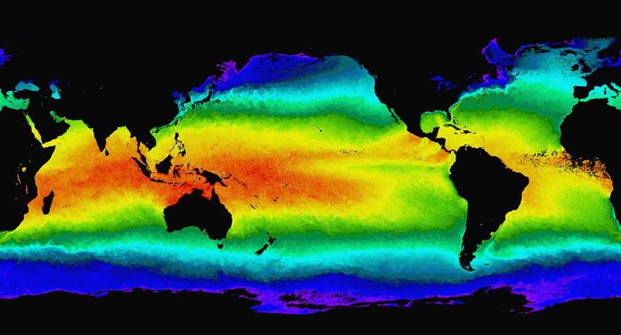
The ITCZ, equatorial waves and the ISO
Prospects for understanding & prediction?
Peter Webster
Violeta Toma and Hyemi Kim
School of Earth and Atmospheric Sciences
Georgia Institute of Technology
Atlanta, Georgia, USA
6-07-2012

Slide 2
This presentation contains a few movies that will play on a Mac.
In pdf form, the movies will not run. But if you go to
http://webster.eas.gatech.edu/talks.html
You can download a pptx copy of the presentation with movies.

Slide 3
This investigation began nearly 15 years ago when Bob Tomas and I wondered why the ITCZ was displaced from the equator in some regions and not in others. The idea of inertial instability arose: the “forgotten” instability!
We were joined by Jim Holton who raised some interesting questions about the generality of the linear inertial stability criteria to tropical flows. We are indebted Dave Raymond for reminding us of this problem that we have subsequently solved.

Slide 4
Violeta Toma and I decided to “rethink” the problem and try and understand the linkage between the mean ITCZ and the transient ITCZ. Out of this has emerged a theory for the generation of easterly waves and (coincidently) the inertial stability of the summer monsoon flow in the Indian Ocean.
I have also become concerned about the lack of differentiation between free and forced tropical modes. In particular, I think the concept or application of the “convectively coupled modes requires some further thought. We start that process here.

Slide 5
Still awaiting is a theory for the formation of the low-frequency oscillations in the Indian Ocean.
Still awaiting a reliable prediction scheme of the ISO. Note the usefulness to less-developed agriculture
Anyhow, in memory of Jim. Sadly and sorely missed!

Slide 6
Some pertinent papers:
Tomas and Webster, 1997: The role of inertial instability in determining the location and strength of near-equatorial convection. Quar. J. Roy. Met. Soc., 123, 1445-1482.
Tomas, Holton and Webster, 1999: The influence of cross-equatorial pressure gradient on the location of near-equatorial convection. Q. J. Roy. Meteor. Soc., 125, 1107-1127
Toma, Webster, 2010: Oscillations of the intertropical convergence zone and the genesis of easterly waves. I Theory and diagnostics. Clim. Dyn. doi: 10.1007/s00382-009-0584-
Toma, Webster, 2010: Oscillations of the intertropical convergence zone and the genesis of eeasterly waves. II Numerical experiments. Clim. Dyn. doi: 10.1007/s00382-009-0585-9
Tom X. and P. J. Webster, 201X ……………………..
There are many others working on this problem and they will be mentioned throughout the talk

Slide 7
Acknowledgements (former students, students and collaborators):
Chidong Zhang (RSMS) Bob Tomas (NCAR)
Violeta Toma (GT) Dave Lawrence (NCAR)
Hye-mi Kim (GT) Johannes Loschnigg (OSTP)
Hai-Ru Chang (GT) Roger Lukas (UH)
Carlos Hoyos (UM: Colombia) Bill Lau (NASA)
Paula Agudelo (UM: Colombia) Bin Wang (UH)
Matt Wheeler (BoM Australia) Weiqing Han (CU)
Harry Hendon (BoM Australia) Dick Johnson (CSU)
Tim Palmer (Oxford) Galina Chirikova (CSU)
Graeme Stephens (JPL) Greg Holland (NCAR)
Judith Curry (GT) Bob Houze (UW)
Jim Holton (UW) Fernando Hirata (GT)

Slide 8
OVERVIEW:
Convection in the tropics from transients to intraseasonal oscillations.
Composite intraseasonal oscillations: how representative are these of any one ISO?
The issue of forced and free tropical oscillations: Need for clarification
Back to basis: Scaling in the tropics: The Charney dilemma.
What forces equatorial convection? A discussion of instabilities
The cross-equatorial pressure gradient world and inertial instability (stability)
Regions of inertial instability and stability
Indian Ocean stability
Return to the ISO: Thoughts on generation
Prediction of the ISO

Slide 9
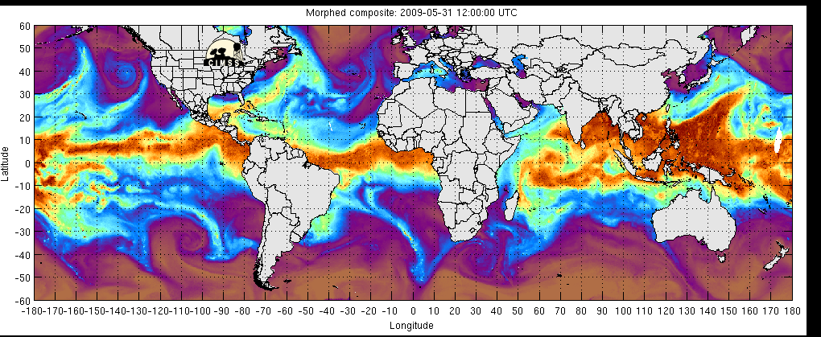
A Day in the Tropics
Precipitable water
Latitude of the ITCZ varies as a function of longitude
Intensity varies with longitude
Transients move along the ITCZ
No land data (yet)

Slide 10
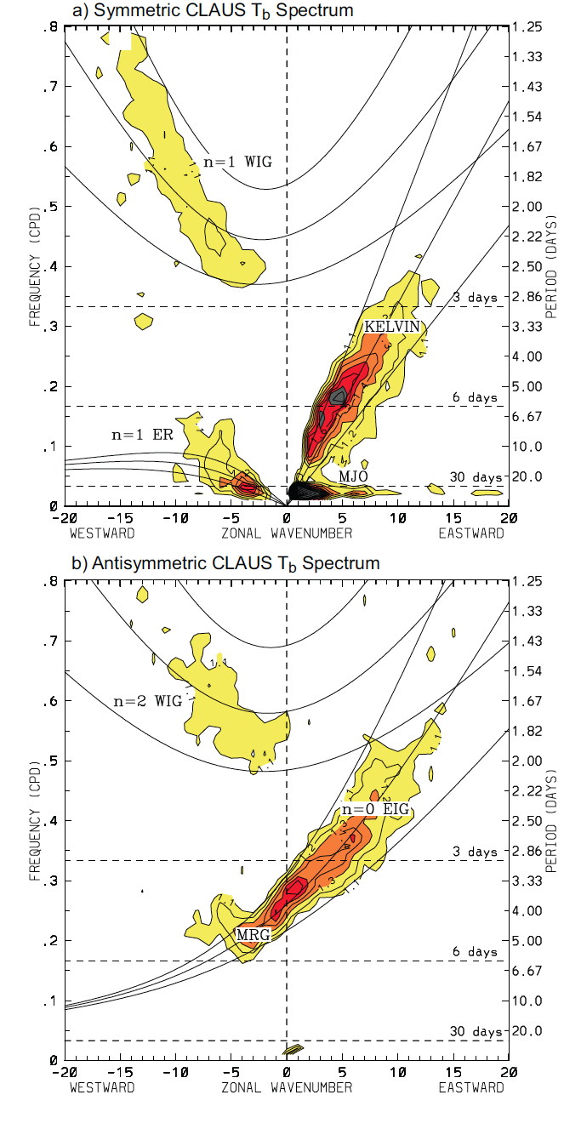
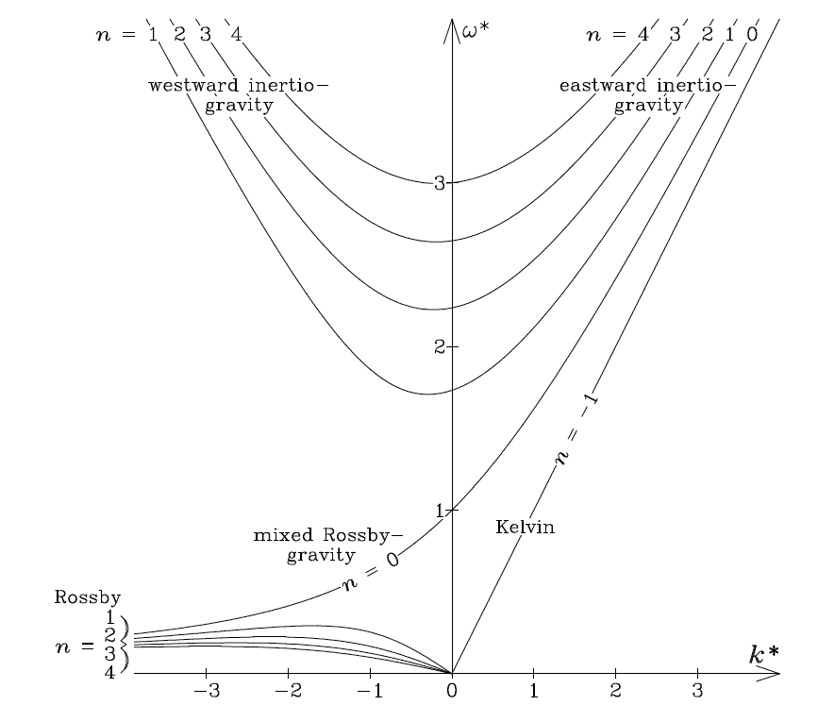
From Wheeler and Nguyen (2012)
Westward Eastward
Normal mode dispersion curves:
OLR variance lines up well with modes but relative to 20-50m equivalent depths.
Scaling of undisturbed tropics should possess equivalent depths of order 500-1000m reflecting the non-divergent nature of the base tropics
Filtered OLR variance plotted on dispersion curve

Slide 11
Note the prominence of the low frequency, long wavenumber and eastward propagating MJO or, more generally, intraseasonal variability
From Wheeler and Nguyen (2012)

Slide 12
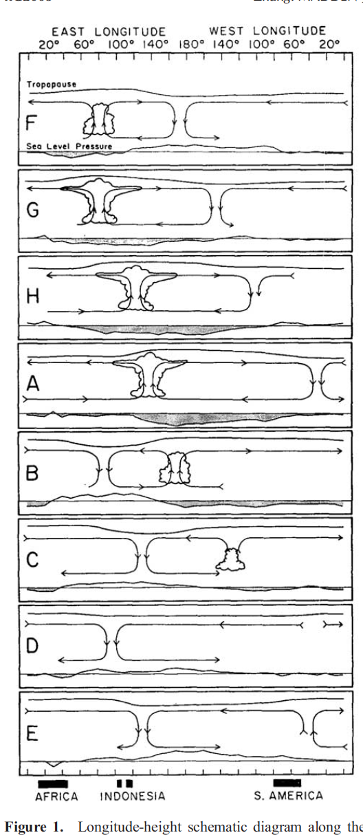
Traditional Madden-Julian Oscillation
Madden and Julian noted a slow eastward propagation of convection out of the Indian Ocean into the warm pool suggesting large-scale teleconnections along the equator.
For future reference note that the scale of the phenomena is about 10,000 km.
Whether or not the mode continually circumnavigates the planet or reforms in the IO (or the Amazon: not noted by M&J) has been subject of debate although more weight on on latter.
Irrespective, the MJO (or ISO) perturbs weather in the tropics and the subtropics.
It is not understood physically nor is it predicted well.
Madden and Julian 1971, Zhang 2005

Slide 13
Prediction skill for summer MJO (Wheeler and Hendon RMM index)
Predictand: RMM index (Wheeler and Hendon 04)
Wheeler and Hendon (2004) 8-phases OLR and U850
P-1
P-2
P-3
P-4
P-5
P-6
P-7
P-8

Slide 14
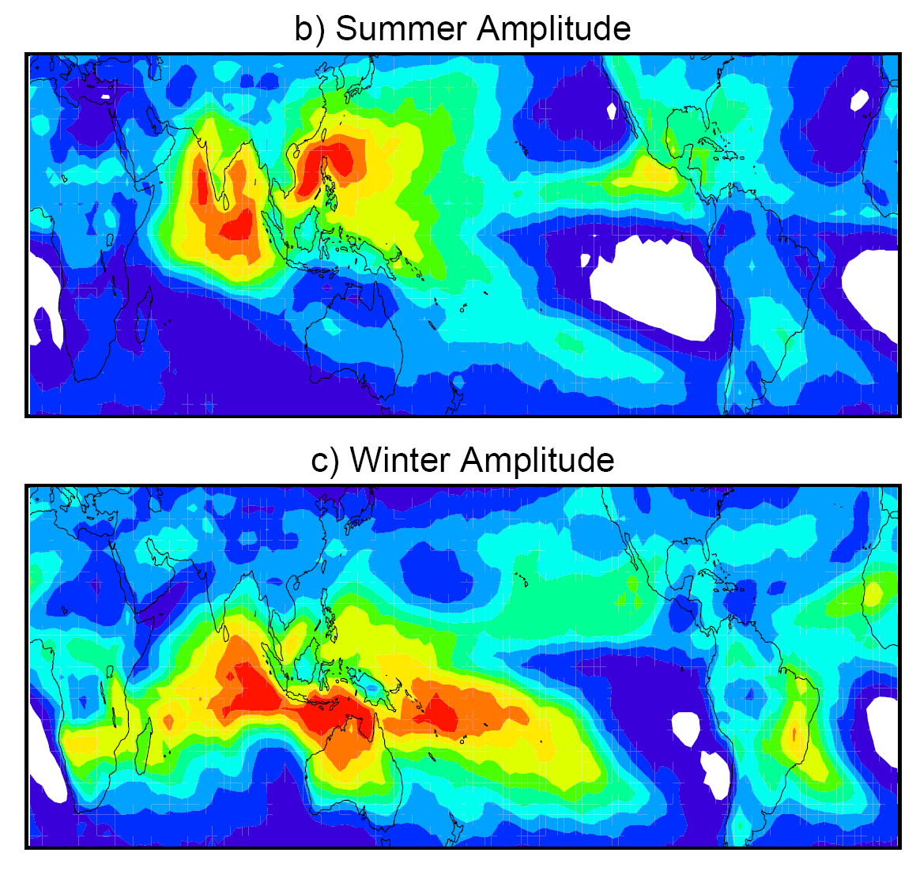
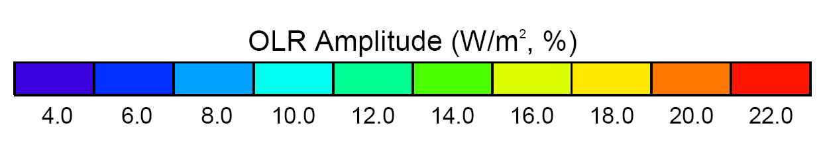
Amplitude of the Intraseasonal variability (25-80 days)
Notes:
Amplitude of ISO variability compared to the amplitude of the annual cycle. In monsoon regions, and tropical regions in general, the ISO is the most important time scale to predict for applications. Why can’t numerical models predict this variability?

Slide 15
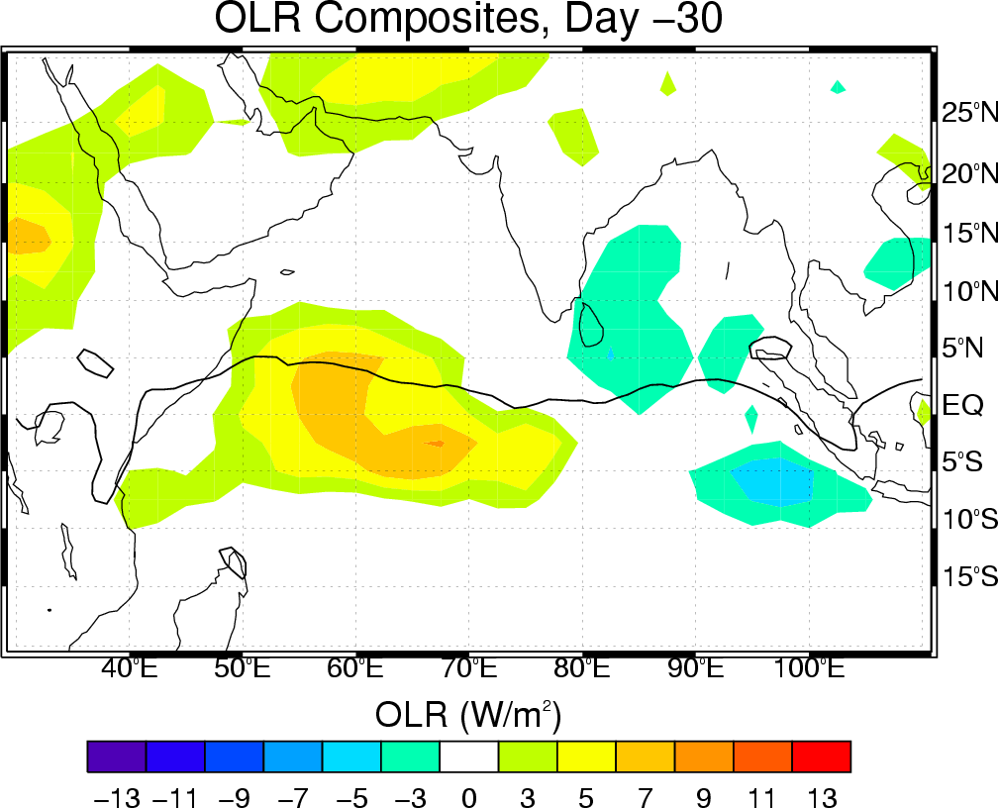

Slide 16
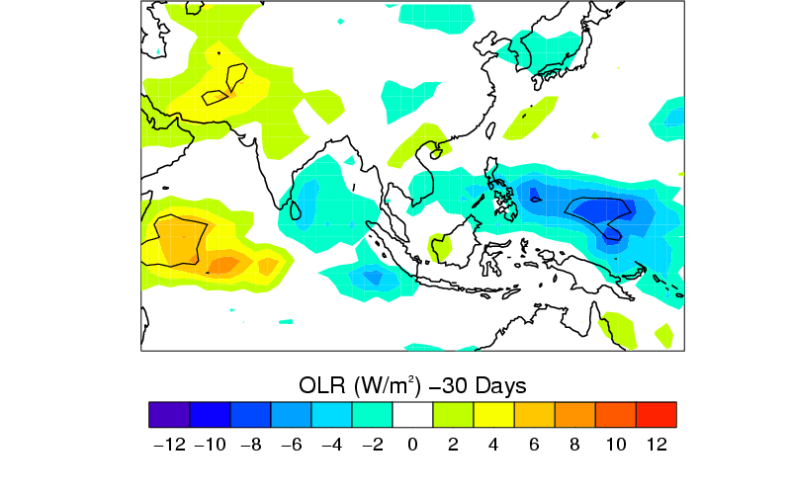
Composite summer ISO:
Day 0: max convection in equatorial EIO

Slide 17
ISO SPATIAL SCALE
12,000 km

Slide 18
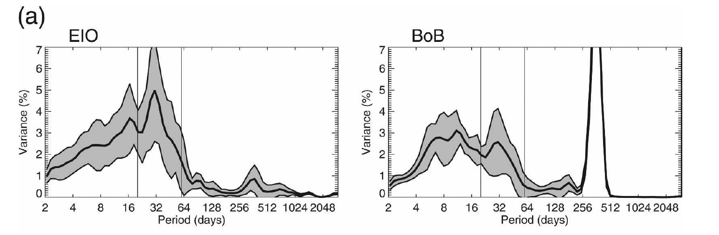
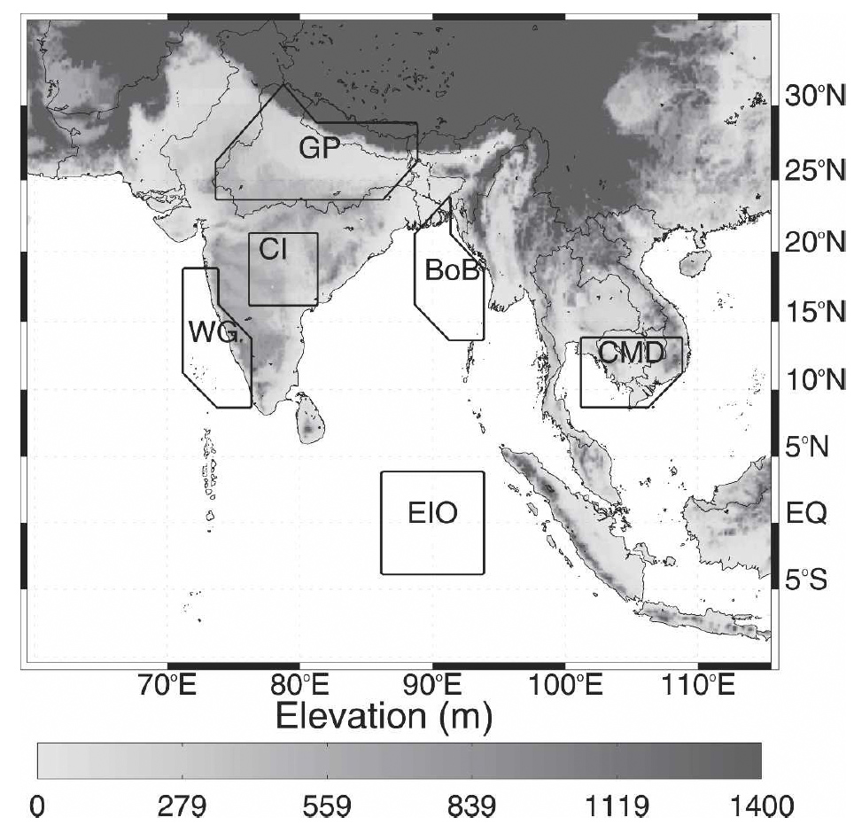
INDIAN OCEAN OLR SPECTRA
EIO
BoB
East Indian Ocean OLR spectra does not contain significant peak in 4-8 day range although BoB does (later!)
Hoyos & Webster 2007

Slide 19
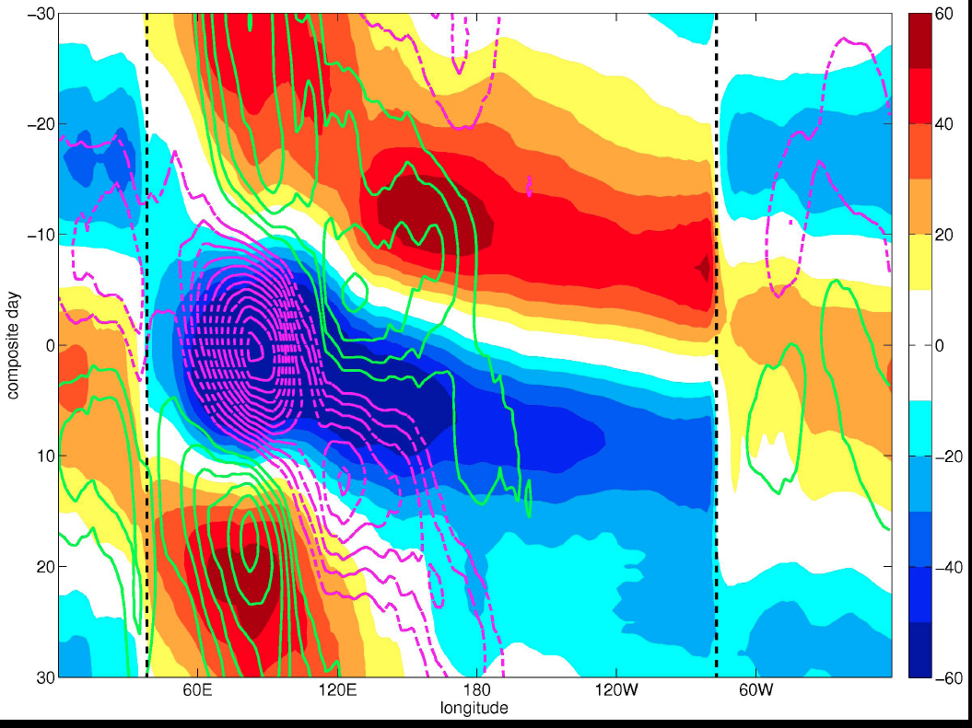
Segmented lower troposphere on MJO time scales
Note two time-scales for surface pressure (long) and convection (short)
A two-scale tropics?
Are these equatorial mountain ranges important in the initiation/demise of MJO?
If so does this suggest a role for the modified transients:
MSLP
longitude
OLR
East African highlands
Andes
Courtesy: Fernado Hirata GT

Slide 20
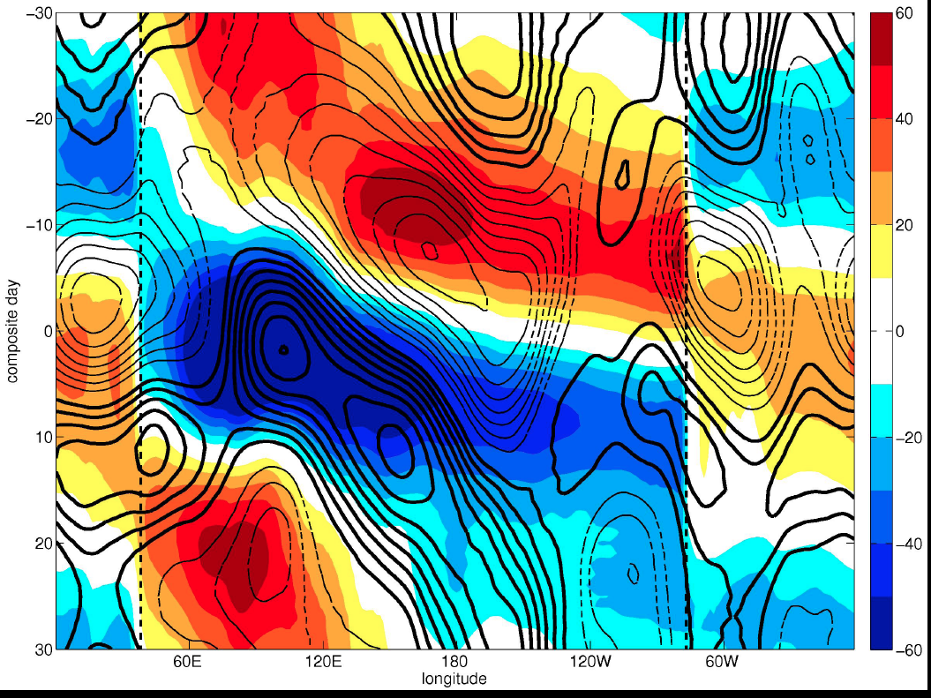
Segmented upper troposphere on MJO time scale
Contours: 200 hPa geopotential
Colors: MSLP
Convection and upper-tropospheric convection alligned
Discontinuities of geopotential at Andes and East African highlands
MSLP
longitude
200 hPa
East African highlands
Andes
Courtesy: Fernado Hirata GT

Slide 21
Representativeness of the composites
The M&J, W&H and Hirata figures all suggest an ordered sequence of propagation from east to west.
How representative are the composites of an individual ISO?
Although a proper measure of variance about the composites has not been computed we can look at some individual ISOs.
This is important because most empirical prediction schemes depend upon composite behavior.
We start with the three DYNAMO ISOs: 2 similar and one different.

Slide 22
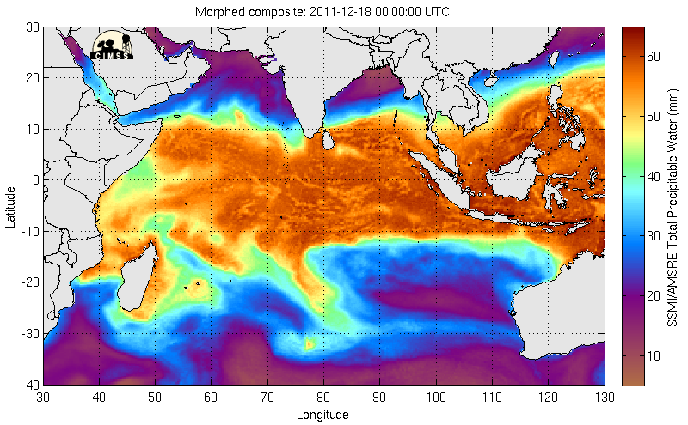
DYNAMO ISO: DEC 18-21, 2011
Data http://tropic.ssec.wisc.edu/real-time/mimic-tpw/ UWis/NOAA/CIMMS_MIMIC

Slide 23
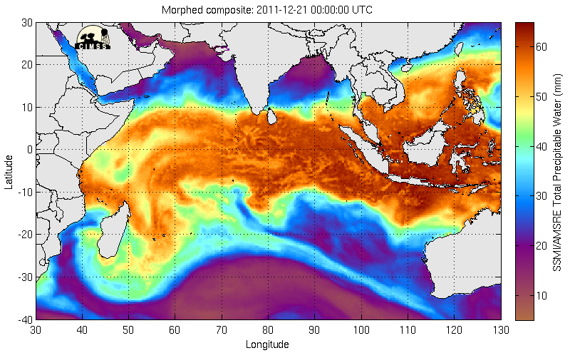
DYNAMO ISO: DEC 20-22, 2011
Data http://tropic.ssec.wisc.edu/real-time/mimic-tpw/ UWis/NOAA/CIMMS_MIMIC

Slide 24
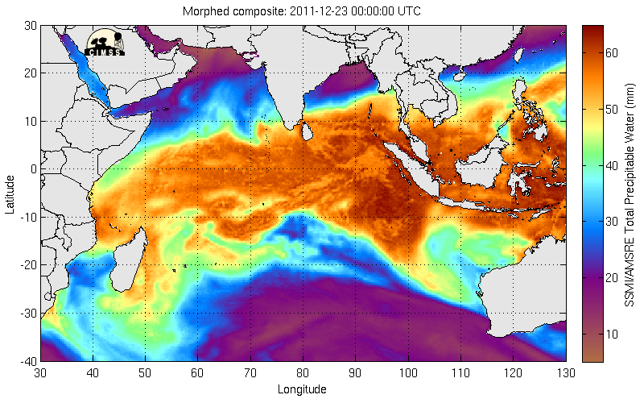
DYNAMO ISO: DEC 23-25, 2011
Data http://tropic.ssec.wisc.edu/real-time/mimic-tpw/ UWis/NOAA/CIMMS_MIMIC

Slide 25
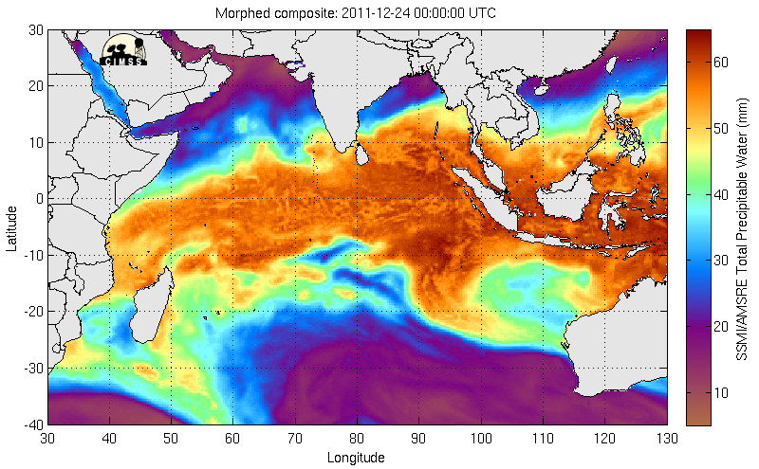
DYNAMO ISO: DEC 24-26, 2011
Data http://tropic.ssec.wisc.edu/real-time/mimic-tpw/ UWis/NOAA/CIMMS_MIMIC

Slide 26
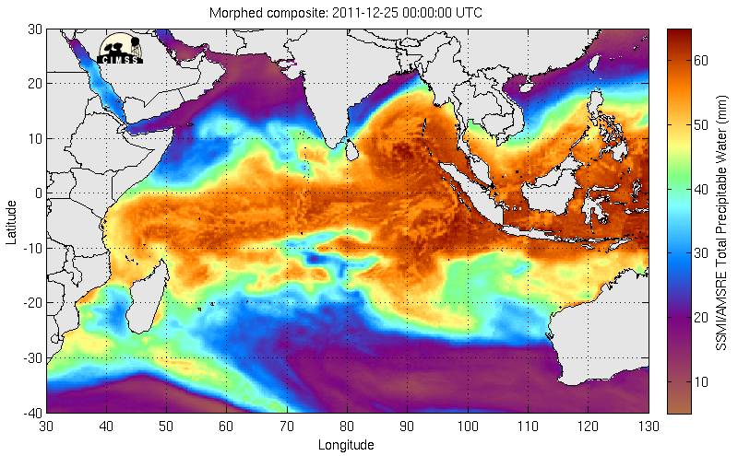
DYNAMO ISO: DEC 25--27, 2011
Data http://tropic.ssec.wisc.edu/real-time/mimic-tpw/ UWis/NOAA/CIMMS_MIMIC

Slide 27
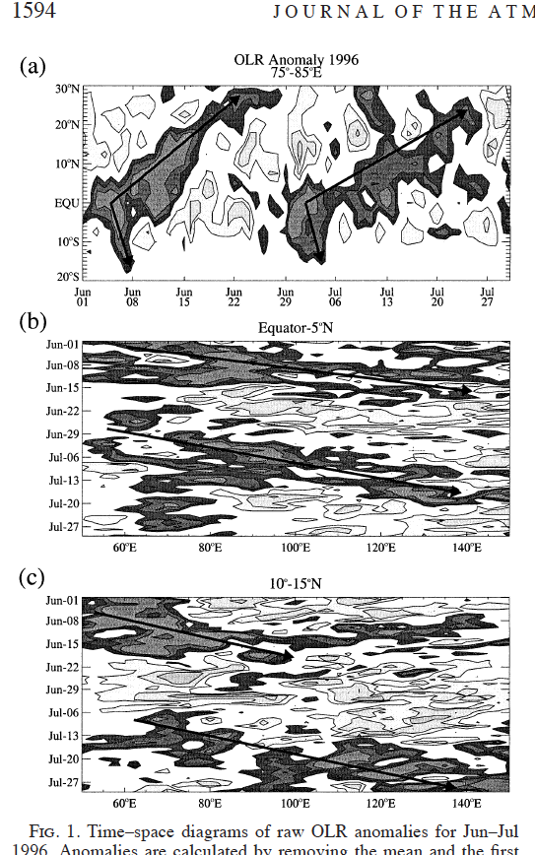
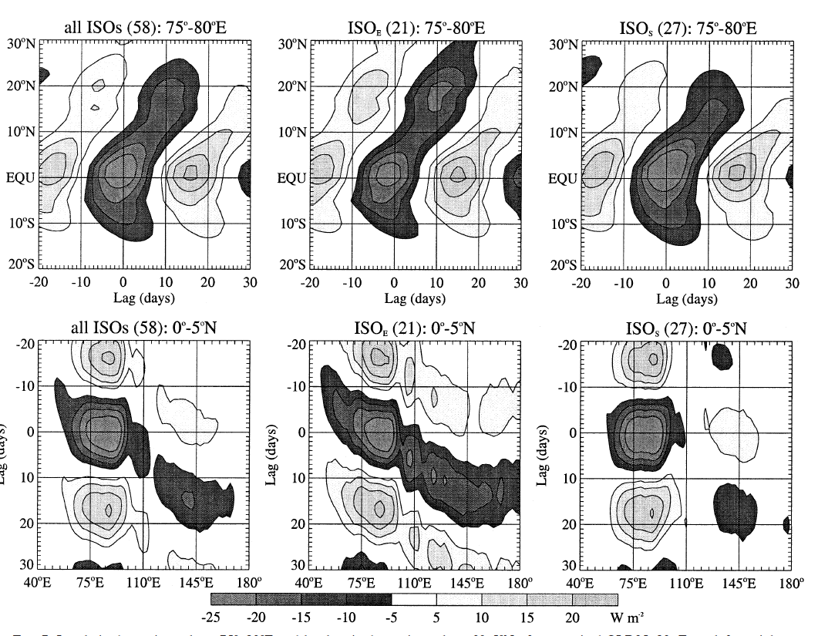
Components of the composites (Lawrence & Webster 2002)
L&W (2002) found distinct classes of ISOs with very different characteristics. Some developed in situ and remained in the IO, some moved north and others propagated eastward.
No precursor behavior was found.
Individual ISOs showed large differences in the longitudinal and latitudinal propagation

Slide 28
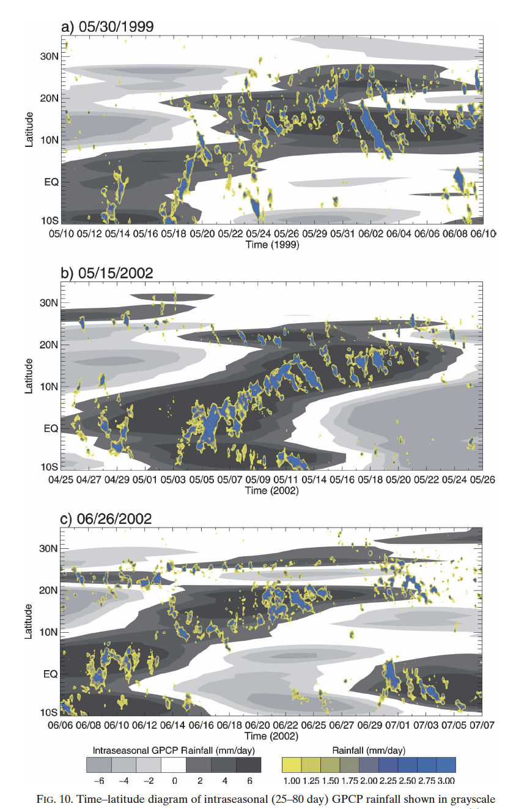
Three ISOs exhibiting general north-easterly propagation.
Note the northeasterly propagation of the ISO as depicted by the low resolution GPCP.
Note too the counter propagating transients imbedded in the low-frequency ISO
In order to understand and predict the ISO, do we need to take these transients into account?
GPCP and TRMM satellite data
Hoyos and Webster 2007

Slide 29
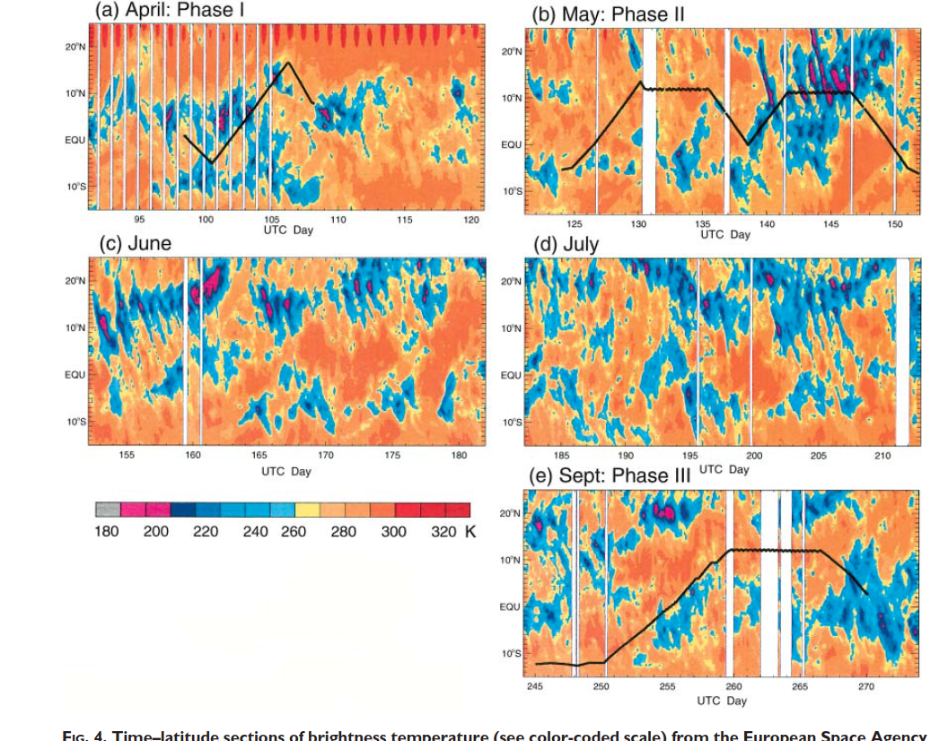
Ditto in 1998 during the 1999 JASMINE field phase
Webster et al 2002

Slide 30
Basic scaling in the tropics
Is it possible to gain some insight into the basic properties of convective modes by returning to fundamental arguments?
After this exercise, we will return to discussion of the equatorial waves in general and the ISO in particular.

Slide 31
First, are the tropics hydrostatic?
Consider typical values: U, W, L, D, P and F represent typical horizontal and vertical velocity, pressure, length and depth and frequency.
To obtain a pressure scale, P, we use the zonal momentum equation seeking, successively, inertial (F>>f) and rotational (geostrophic) (F<<f) limits

Slide 32
Now for hydrostatic balance:
So that, if true:
Some questions:
Are convective clouds hydrostatic, convective clusters?
Are gravity waves hydrostatic?
Are the Hadley, Walker cells hydrostatic?
What happens near the equator as f →0? Are equatorially trapped modes hydrostatic?

Slide 33
INERTIAL BALANCE P₁ GEOSTROPHIC BALANCE P₂
If W<<U and D<<L, the system is hydrostatic
Thus convective clouds and clusters are not hydrostatic
Gravity waves are hydrostatic
Even if W≈U and D≈L, the system is hydrostatic as long as F<<f
For synoptic scale tropical features (L≈a), L still >>D and system is hydrostatic
Importantly, even as F tends to small f near the equator, large scale features are still hydrostatic. Equatorially trapped modes (R, K and G) may be considered hydrostatic
Note, though, that the hydrostatic circulation features contain no-hydrostatic elements. This is an important, non-trivial issue

Slide 34
Scaling of the thermodynamic variables in the tropics leads to the “Charney Conundrum”, a problem that still persist in tropical meteorology
Note that the geometric terms go to zero near the equator as tan-> 0
R_{o}=U/fL (inertial/rotational)
Horizontal/temporal variability
Mid-latitudes
U, L, f: 10 ms⁻¹, 10⁶ m, 10⁻⁴ s⁻¹
Tropics
U, L, f: 10 ms⁻¹, 10⁶ m, 10⁻⁵ s⁻¹
Variability of thermodynamical quantities in tropics order of magnitude smaller than in the extratropics for same scale of motion

Slide 35
Scaling of the thermodynamic variables in the tropics leads to the “Charney Conundrum”, a problem that still persist in tropical meteorology
(1) Note that for very large scale motions in the tropics L: 10⁷ m (Hadley, Walker), that thermodynamical quantities scale as 10⁻², same as mid-latitudes for 10⁻⁶ m
But for the moment, we are interested in the scales of motion of convective waves in the tropics (10⁶ m)
(2) We can also obtain a scaled version of the continuity equation. Noting that
and
then:
Horizontal/temporal variability
Mid-latitudes
U, L, f: 10 ms⁻¹, 10⁶ m, 10⁻⁴ s⁻¹
Tropics
U, L, f: 10 ms⁻¹, 10⁶ m, 10⁻⁵ s⁻¹
Variability of thermodynamical quantities in tropics order of magnitude smaller than in the extratropics for same scale of motion

Slide 36
There are significant consequences to these thermodynamical scalings in the vorticity equation:
Froude number: F_{R}=U²/gh I.e., (fluid speed/ gravity wave speed)²
Richardson number: R_{I}=gh/U² or =N²H_{S}²/U² (potential energy/kinetic energy)

Slide 37
In mid-latitudes for L: 10⁶ m:
and noting from the scaled continuity equation:
we see that the vorticity equation is fully divergent and the system baroclinic!
z
w

Slide 38
In tropics for L: 10⁶ m:
we see that the vorticity equation is non-divergent and the system barotropic!
For L: 10⁷ m:
So on scale of the Hadley and Walker circulations system is divergent allowing communication between the upper and lower troposphere.
10⁶ m
10⁷ m
z
w
w≈0

Slide 39
Some issues arising from the tropical scaling:
Cloud clusters and large areas of organized convection on the scale of 10⁶ m had been observed in the tropics associated with troughs and ridges since WW2. Yet Charney’s scaling suggested that the atmosphere would be extremely stable on these scales. Charney’s conundrum! What produces these convective waves?
It was noted too, relatively early in the Atlantic but much later in the Pacific, that there were source regions for these modes.
Charney wrote a second scaling paper in which he showed that in regions of convection, the static stability would be less and the vorticity equation would become divergent on L:10⁶ m scales.
But this begged the question of what produced the reduced static stability. In essence, his argument was an artifact (perhaps similar to convectively coupled waves) that there is a consistency between heating and waves. We will briefly consider this question.

Slide 40
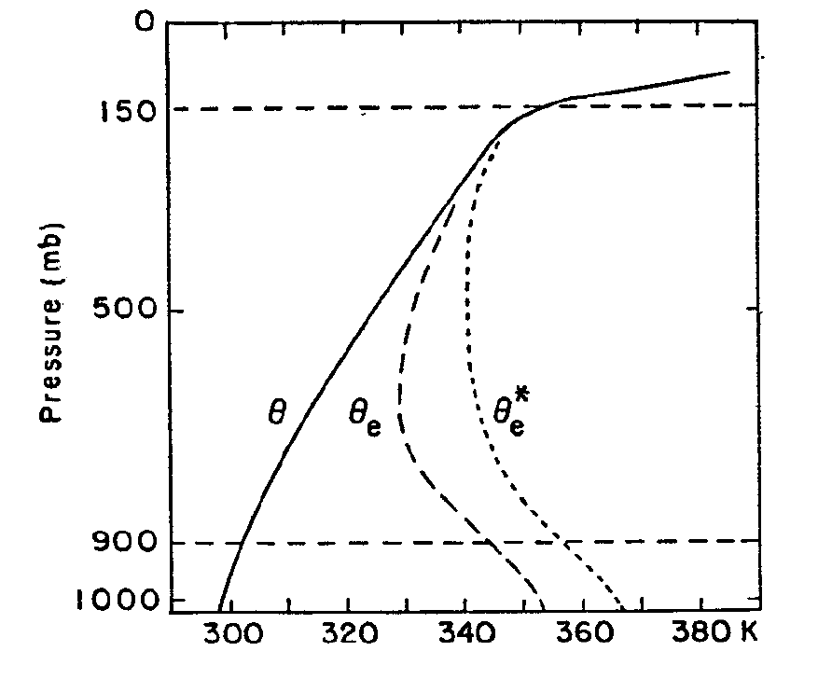
Suggestions to solve Charney’s conundrum:
The tropical atmosphere is highly convectively unstable.
This may be referred to as convective instability of the first kind. Potential temperature increases height (statically stable) there is a deep mid-tropospheric equivalent potential temperature minimum so that the mid-troposphere is extremely stable.

Slide 41
Suggestions to solve Charney’s conundrum:
(2) Convective instability of the second kind
Below the theta-e minimum there is deep moist layer which is potentially unstable. Charney proposed that low level cyclonic vorticity, albeit weak, could cause frictional convergence and vertical Ekman pumping. This upward velocity would raise moist parcel, release latent heat and deepen the cyclonic zone and so on. Unfortunately, the most unstable scale was the cumulus cloud. Not 10⁶ m!
frictional convergence

Slide 42
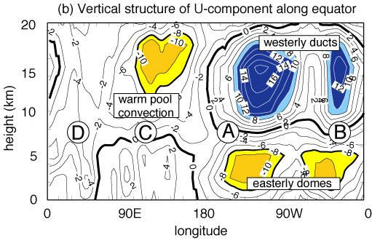
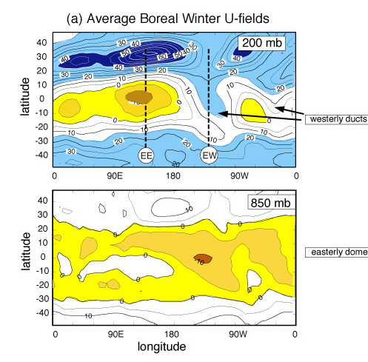
Suggestions to solve Charney’s conundrum………
Lateral forcing by propagating higher latitude waves
Assuming a zonally symmetric basic state, waves reflected at U=C_{ph} and couldn’t penetrate deeply into the tropics (Mak 1969). But realization that there were regions where the the upper tropospheric westerlies penetrated to the equator (e.g., mid-Pacific) extratropical modes can penetrate but not into lower troposphere (Webster & Holton 1982).

Slide 43
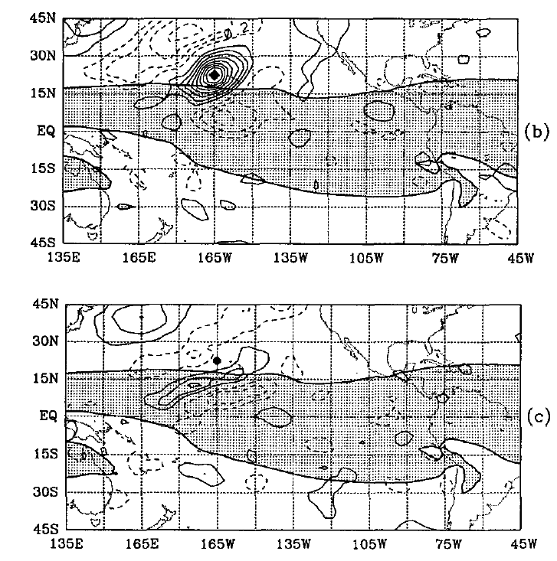
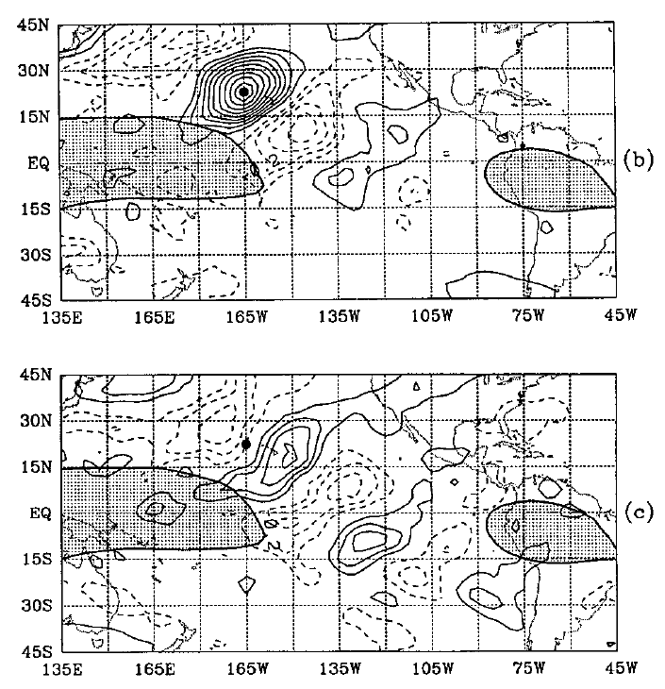
Composites relative to extratropical disturbance
315K 1-day lag 345K 1-day lag
315K 3-day lag 345K 3-day lag
Tomas & Webster 1994

Slide 44
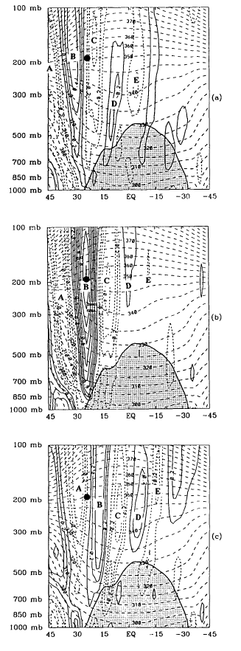
Vertical one-point correlation fields using DJF 6-30 day IPV in section across equator with 22.5N, 165W at 200 hPa.
Lag -3 days lag 0 days lag +3 days
Note differential advection in the vertical. Perturbation moves over easterly dome. Consequences?
Tomas & Webster (1994)

Slide 45
Suggestions to solve Charney’s conundrum………
Dynamic instabilities
Two points made earlier:
(i) There are a number of regions where 10⁶ m waves originate:
East African highlands (Burpee 1972)
West Africa (Vieria, 2010)
East Pacific Ocean (Kalidas-Sena, Toma-Webster)
The regionality suggests that there are specific properties of the background basic state that lead to genesis. Likely large scale instabilities of the basic state generate local instabilities that overcome the thermodynamic stability.
(ii) It is true that convectively coupled modes are consistent with the response of a very shallow fluid (which by definition is divergent) to observed heating profiles. But this argument does not explain how the heating profile arises.

Slide 46
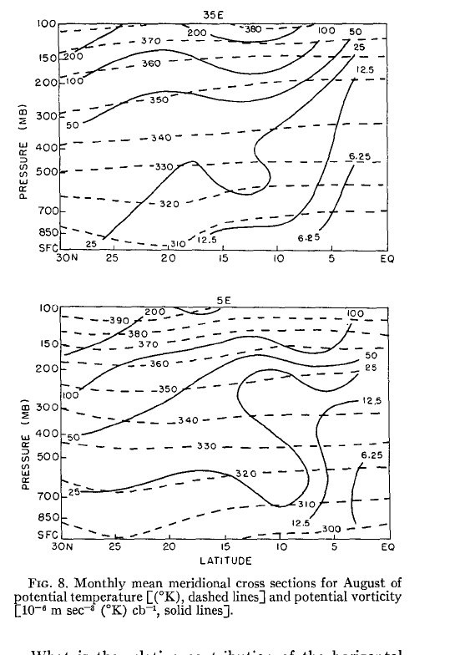
Types of instabilities:
Burpee baroclinic instability:
It is hypothesized that the East African Highland heating reverse the isentropic potential vorticity gradient thus allowing baroclinic modes to grow. Many, but not all, African easterly waves are generated in Central/East Africa.
35 E 5E
Charney-Stern criterion for instability is that latitudinal gradient of potential vorticity changes sign along an isentrope.
Mishra and Salvekar (1980) suggest baroclinic instability is an important mechanism in the formation of cold cored monsoon depressions

Slide 47
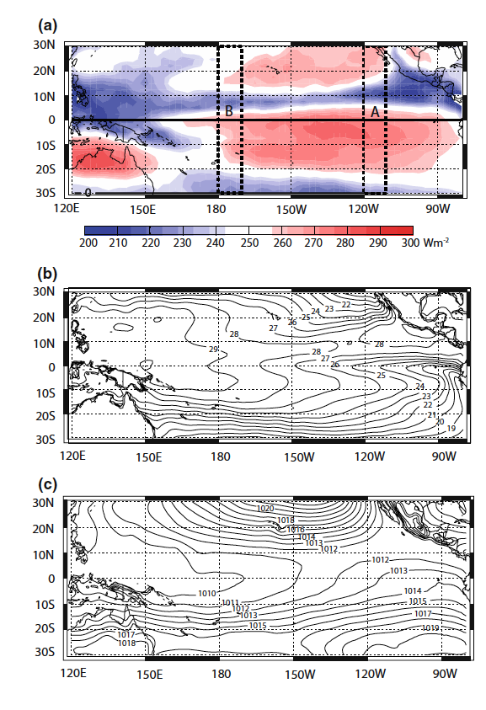
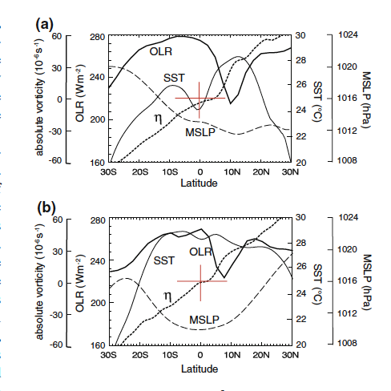
(ii) Inertial stability and instability
Regions of strong cross-equatorial pressure gradients (CEPG) may be inertially unstable. They are also regions where convective waves form.
Note that in regions of strong CEPG max convection lies equatorward of min mslp and maximum SST.

Slide 48
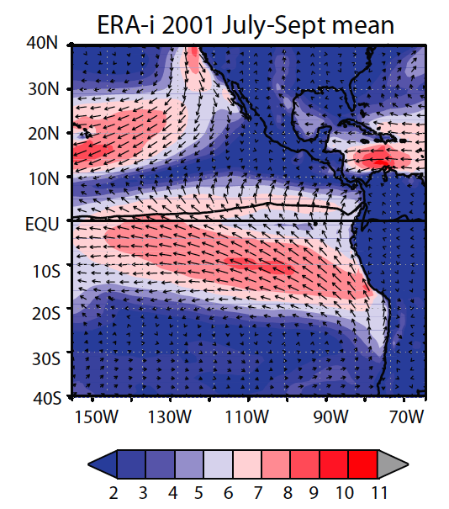
LOW LEVEL WESTERLIES: WHY ARE THEY THERE?
Low-level westerly component occurring with convection
Converging
easterlies into ITCZ

Slide 49
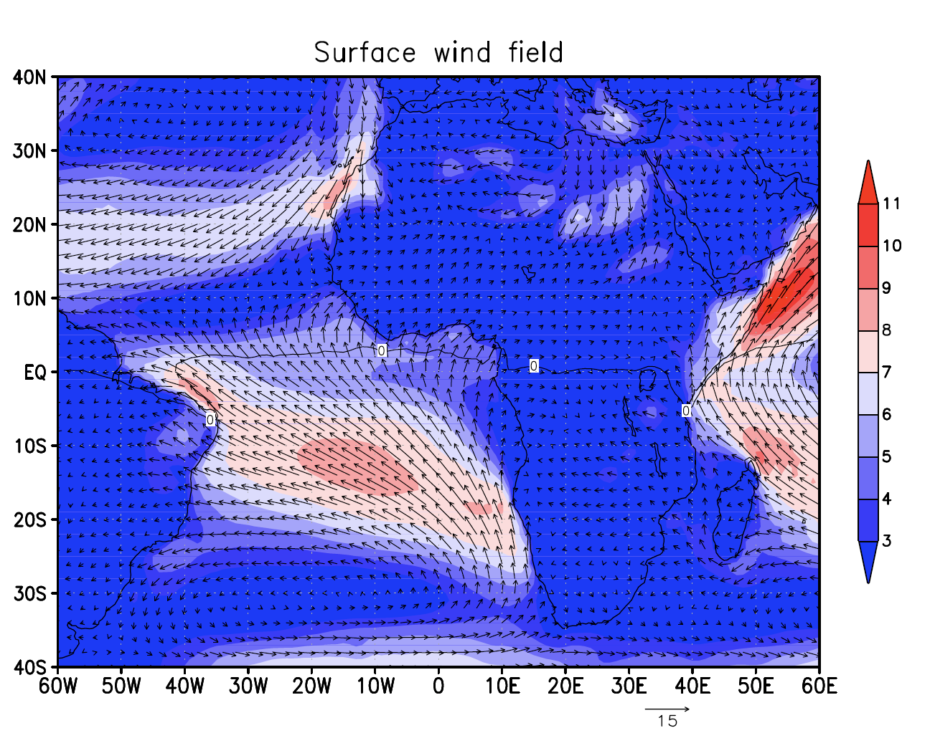
LOW LEVEL WESTERLIES: WHY ARE THEY THERE?
Converging
easterlies
Surface
westerlies

Slide 50
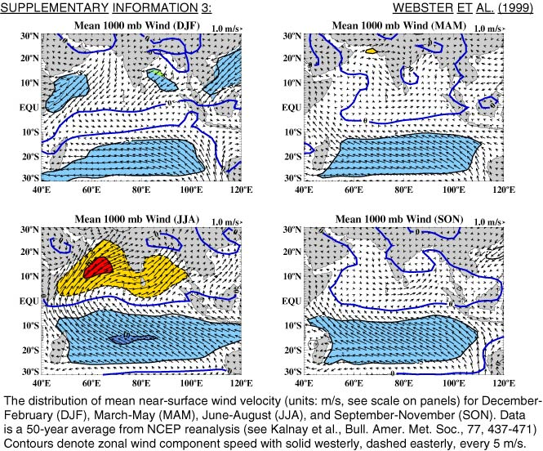
LOW LEVEL WESTERLIES: WHY ARE THEY THERE?

Slide 51
LOW LEVEL WESTERLIES: what do they produce?
upwelling
Development of the South Indian Ocean (Seychelles-Chagos) thermocline ridge:
A climatically sensitive phenomenon

Slide 52
LOW LEVEL WESTERLIES: WHY ARE THEY THERE?

Slide 53
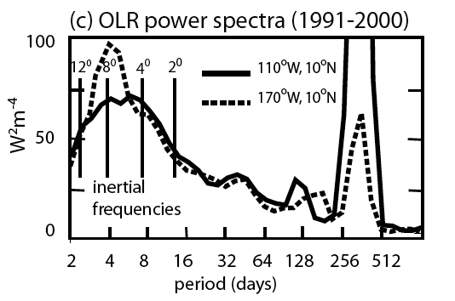
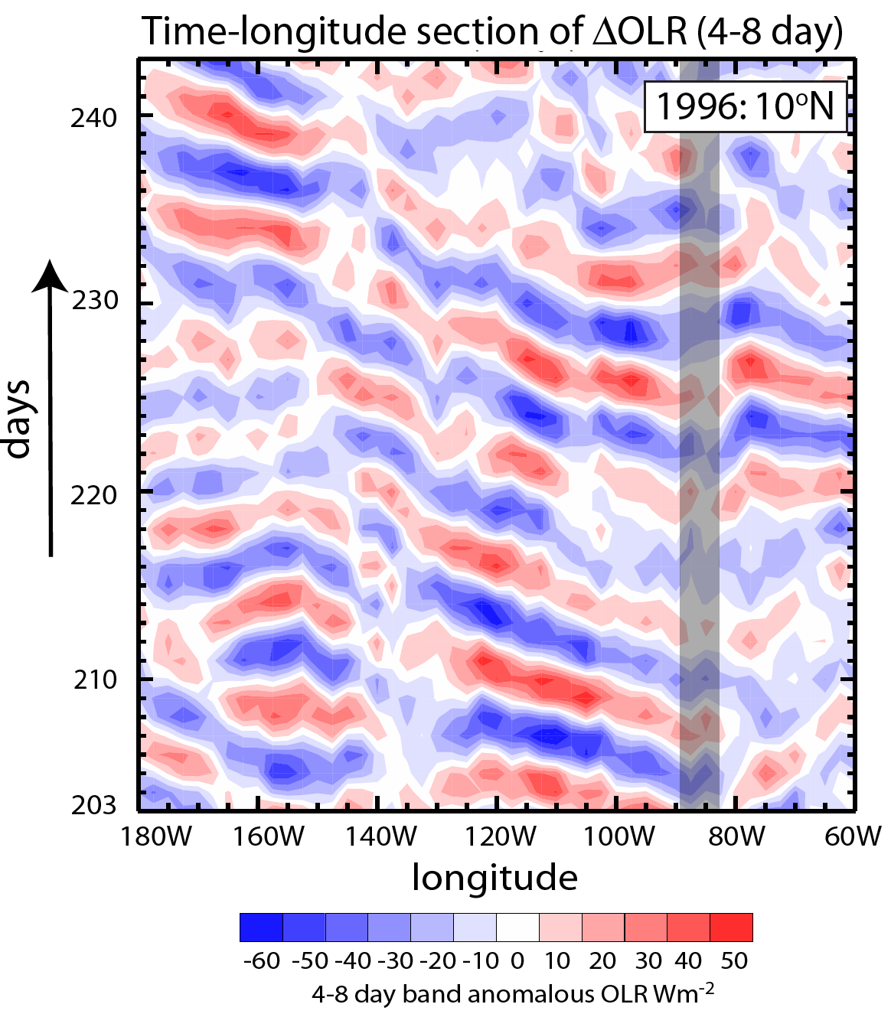
(ii) Inertial Instability
Maximum variance occurs at the inertial frequencies of the region of maximum convection
Serra et al. (2007) note that most of the equatorial waves appear to form in situ in the EPAC
Are the instability oscillations the physical source of the 4-6 day easterly wave?
Toma & Webster 2009

Slide 54
Surface westerlies
divergent wind
mslp min
Low p
SST max
>0
=0
max
CONV
Convection (ITCZ)
f >0
DIV
EQU
EQU
<0
f <0
High p
LARGE CEPG
Convection is off equator on poleward side of =0 contour
Not colocated with mslp min or SST max
Surrounded by convergence/divergence doublet
Coincides with surface westerly jet
Highly variable and transient and deepest convection!

Slide 55
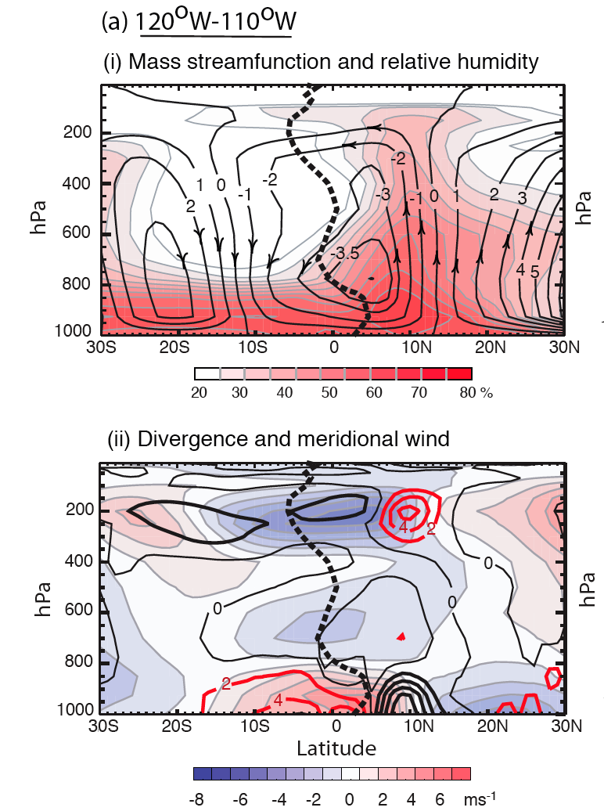
Detail circulation 120-110ºE June-September
Fields show deep penetrative meridional circulation with max convection at about 10ºN.
contour well displaced poleward
Strong div/conv doublet exists about contour

Slide 56
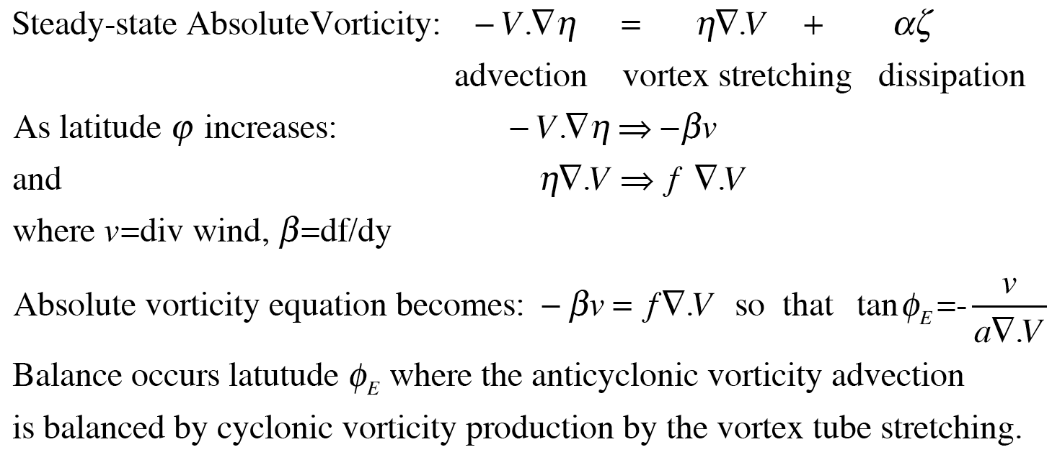
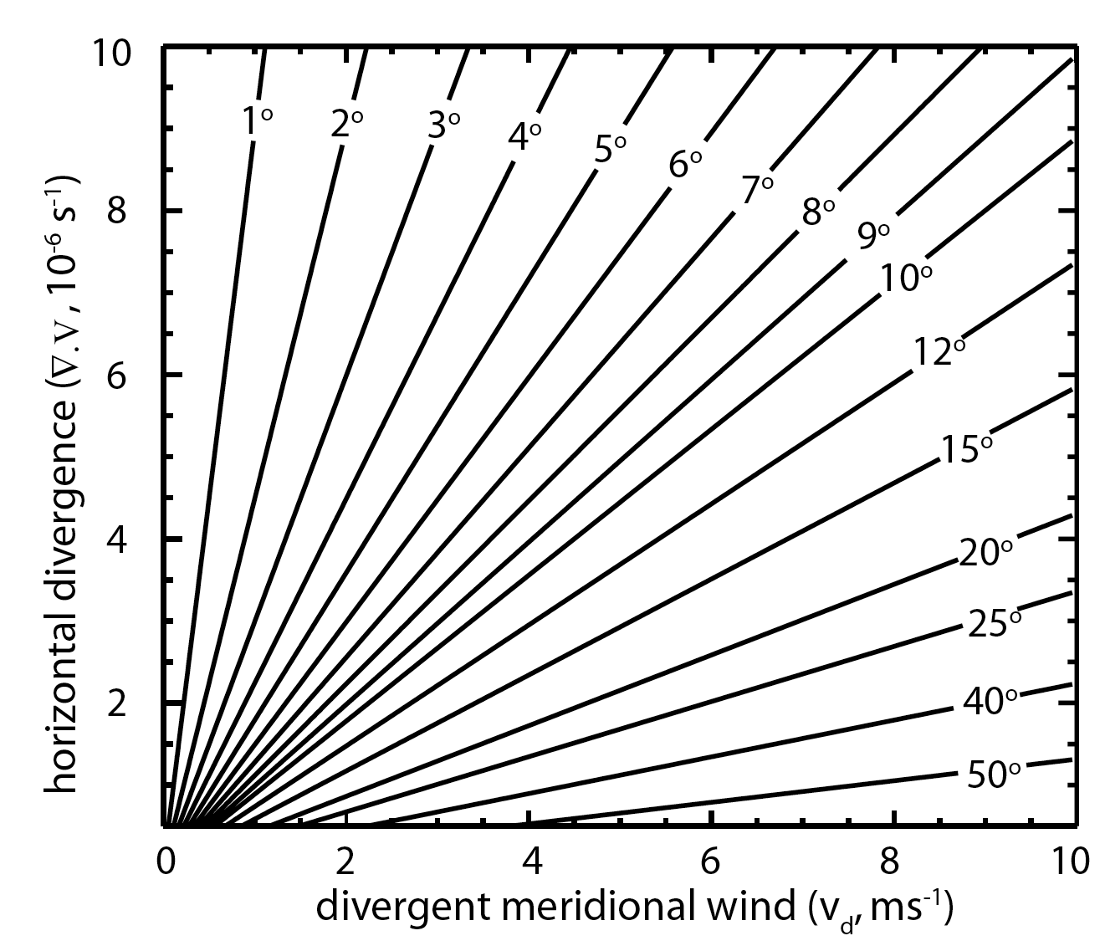
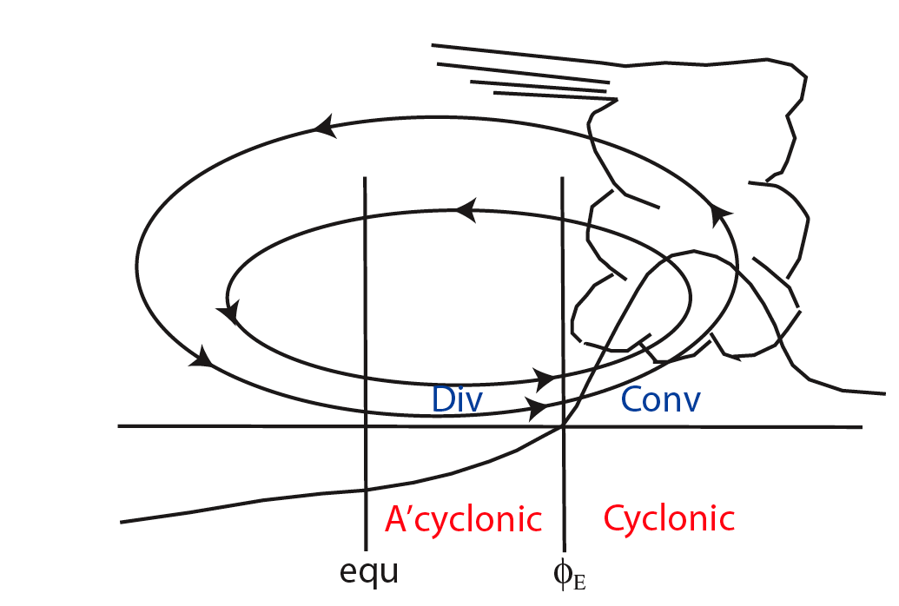
Limits on the mean ITCZ structure

Slide 57
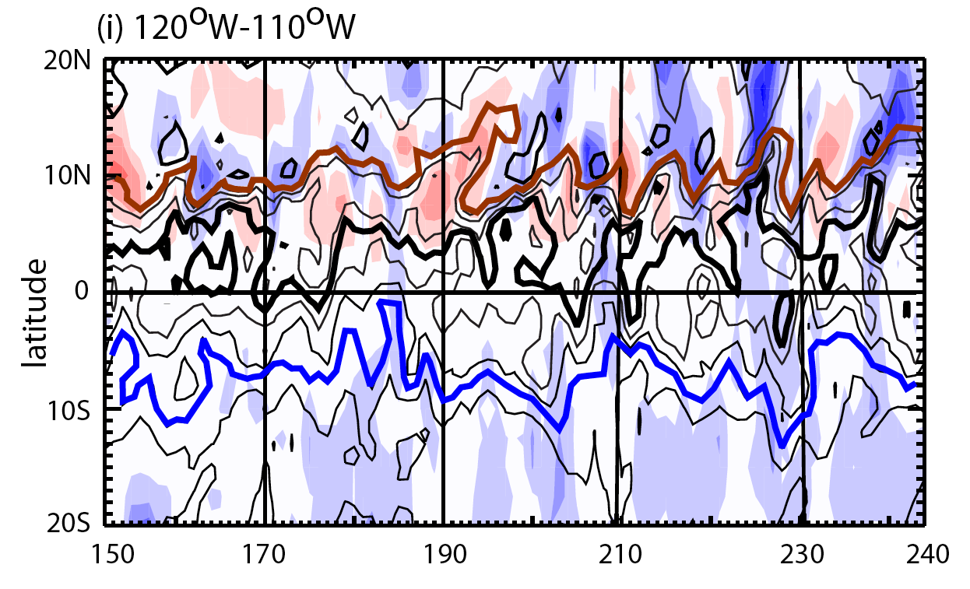
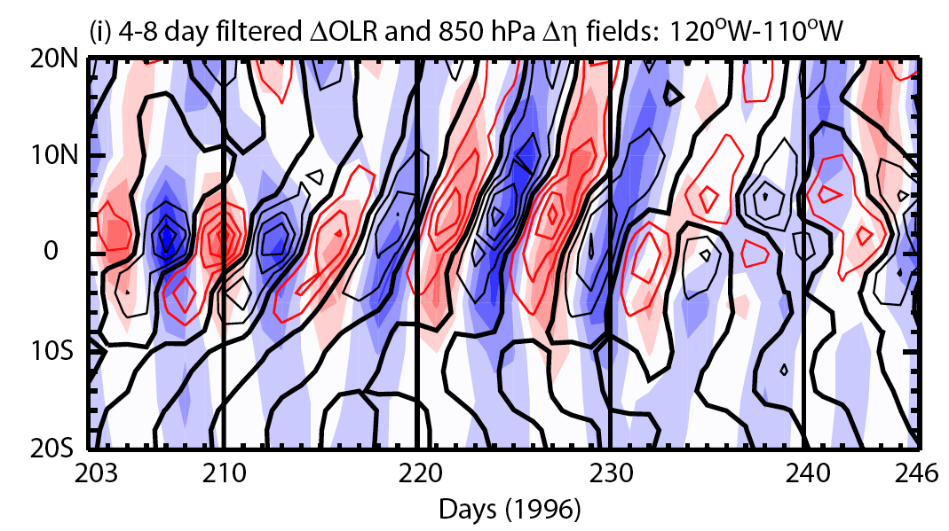
Transients and the Inertial Oscillator
Full field of αβσ ϖορτ is dominated by the mean ITCZ
Band-pass filtering reveals a systematic oscillation with anticyclonic vorticity advancing with little convection (pink) and then rapid convection (blue) and the generation of strong cyclonic vorticity
At this stage the circulation retreats but, because of the constant instability due to unceasing CEPG, advance repeatably
Note that the period of oscillation is inertial period of where convection occurs
Create composites (-3…+3 days)

Slide 58
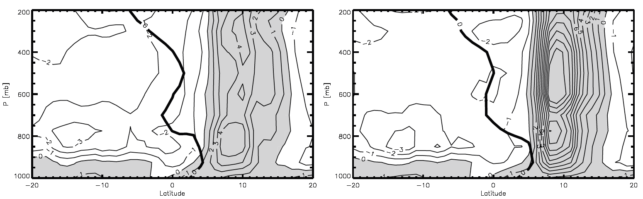
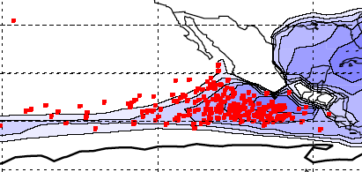
Composite variation of heating rates (K/day)
Heating rate (day 0) day 3
Latent
heating
Latent
heating
radiative cooling
radiative cooling
+4K/day +12K/day
Strong subsidence and radiational cooling dominate equatorward side of ITCZ
“Inertial oscillator” provides heating rate differential of +4 to +12 K/day variability of heating on 4-8 day time scales

Slide 59
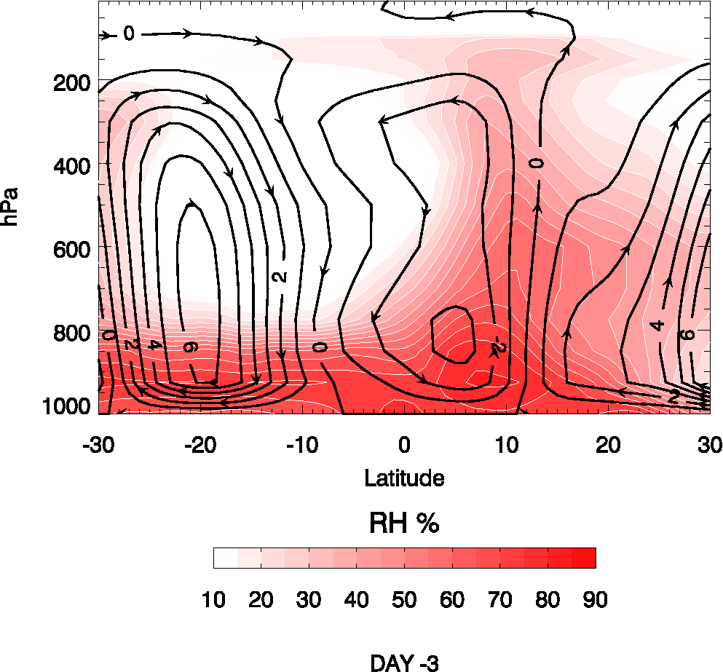
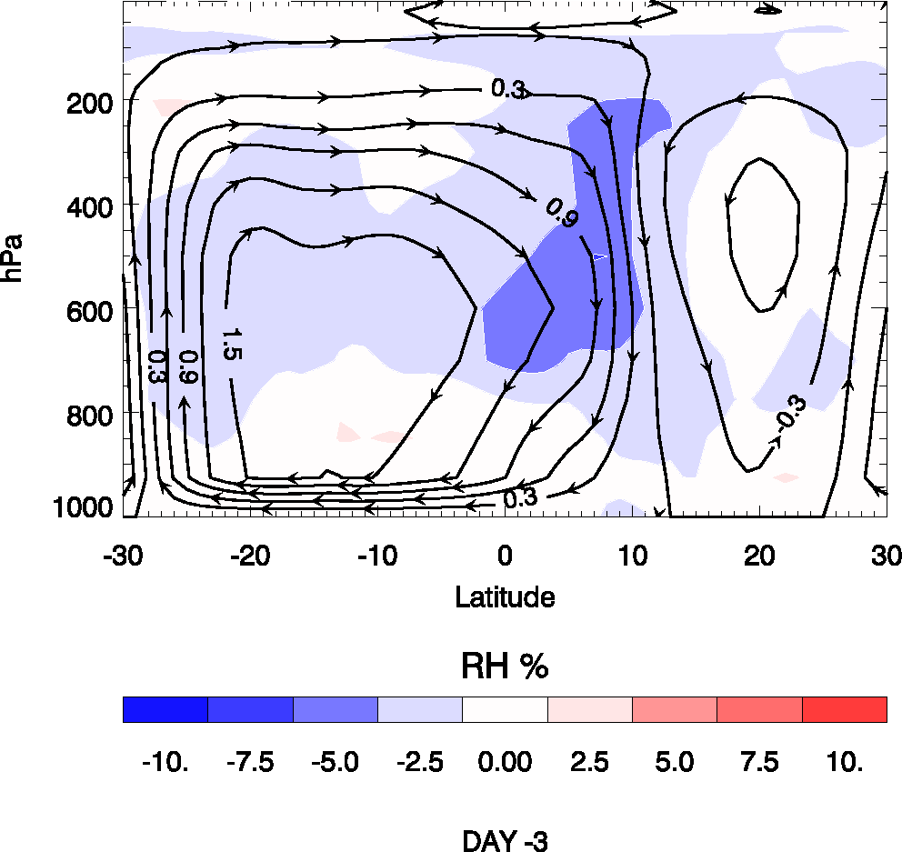
Oscillations of the meridional circulation: 110ºW-120ºW
TOTAL FIELD ANOMALY FIELD

Slide 60
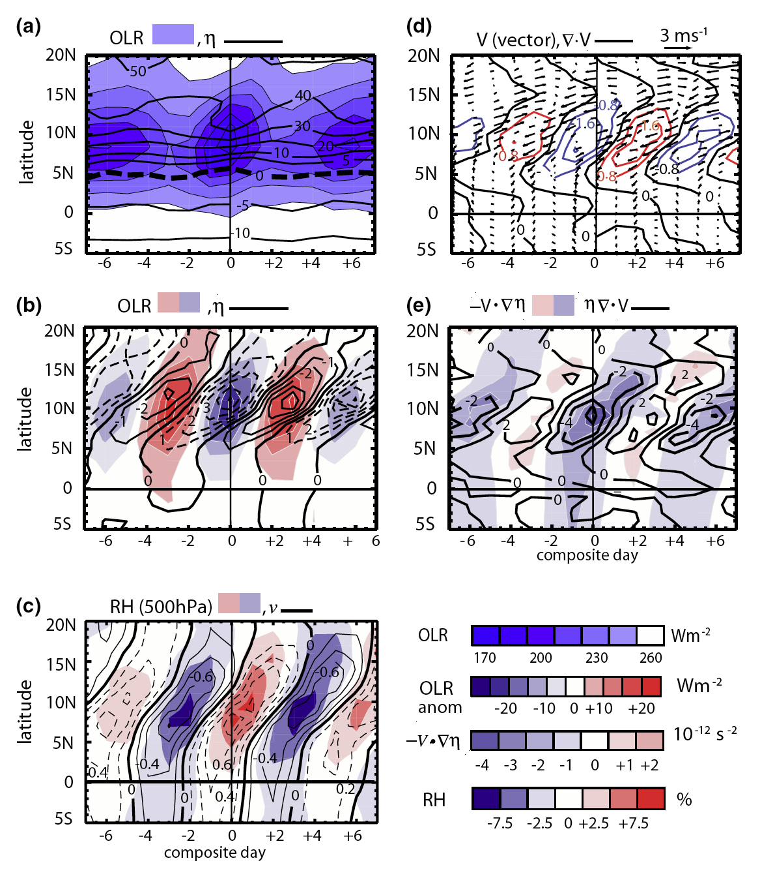
Composite behavior of the terms in the absolute vorticity equation
Note, especially the response of the vortex stretching term to the cross-equatorial advection of absolute vorticity (panel e). Refer to panel (a) for convective response.

Slide 61
Inertial Instability: Cyclonic vorticity, disturbances
Inertial instability theory allows increased understanding two of the basic genesis criteria: location and magnitude of cyclonic vorticity and what produces (at least a high proportion) cyclonic disturbances.
Basis is that there exists in regions of strong slowly varying CEPG, a perpetual instability upon an equilibrium state.
Vortex tube response to cross-equatorial advection of anticyclonic vorticity by divergent wind (induced by SST distribution and CEPG) provides mechanical lifting in potentially unstable convective environment
The time scale of the disturbances is the inertial frequency at the penetration latitude of the limit of penetration of anticylonic vorticity advected by the divergent wind component (itself a function of the CEPG)
The instability produces an oscillation in heating of -4 to -10 K/day. We presume (not proven) that this inertial oscillator projects onto dynamic equatorial modes
Toma and Webster 2010a, b

Slide 62
But …………………
We have developed a theory of the formation of equatorial convectively coupled mode generation.
We have yet to say something about the basic formulation of the ISO.
As yet all one can say is that the ISO is made up of collections of the transient modes we have just discussed.
But, two things are worth remembering:
(i) For L:10⁷m, the tropical vorticity equation is divergent.
Noting that this is the scale of the ISO, could this form he basis of an instability on intraseasonal time scales? .
(ii) Some regions are very inertially stable and these correspond to formation regions of the MJO (particularly the equatorial Indian Ocean.

Slide 63
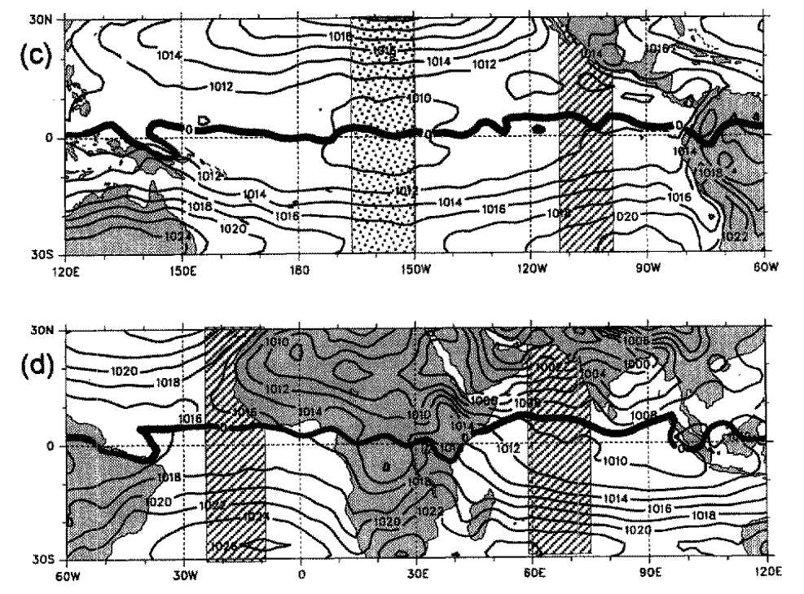
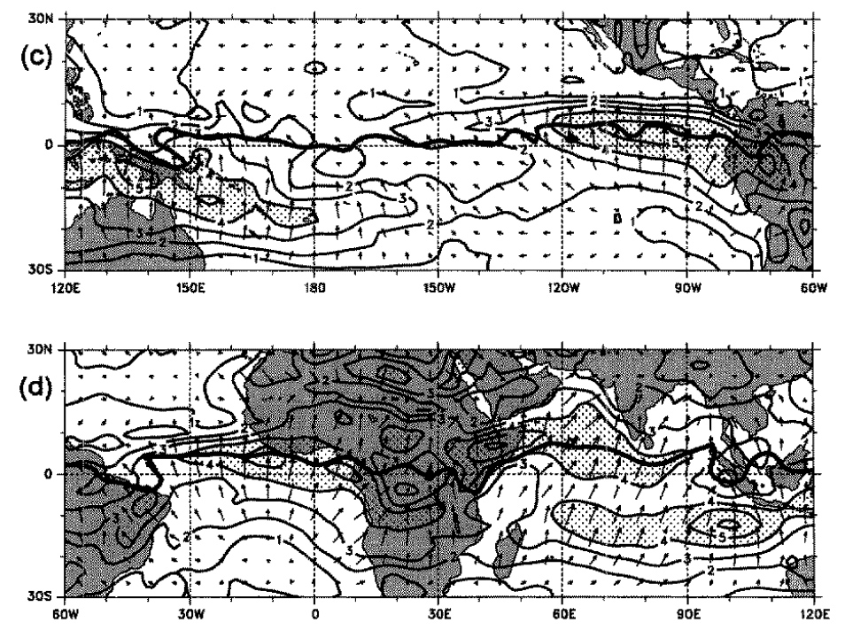
Do these concepts translate to the IO?
MSLP
Divergent wind field 925 hPa
The strongest cross the equator occurs in the Indian Ocean
Largest excursion of zero absolute vorticity contour
Is this region inertially stable or unstable? Transients?

Slide 64
INDIAN OCEAN OLR SPECTRA
EIO
BoB
East Indian Ocean OLR spectra does not contain significant peak in 4-8 day range although BoB does
Hoyos & Webster 2008

Slide 65
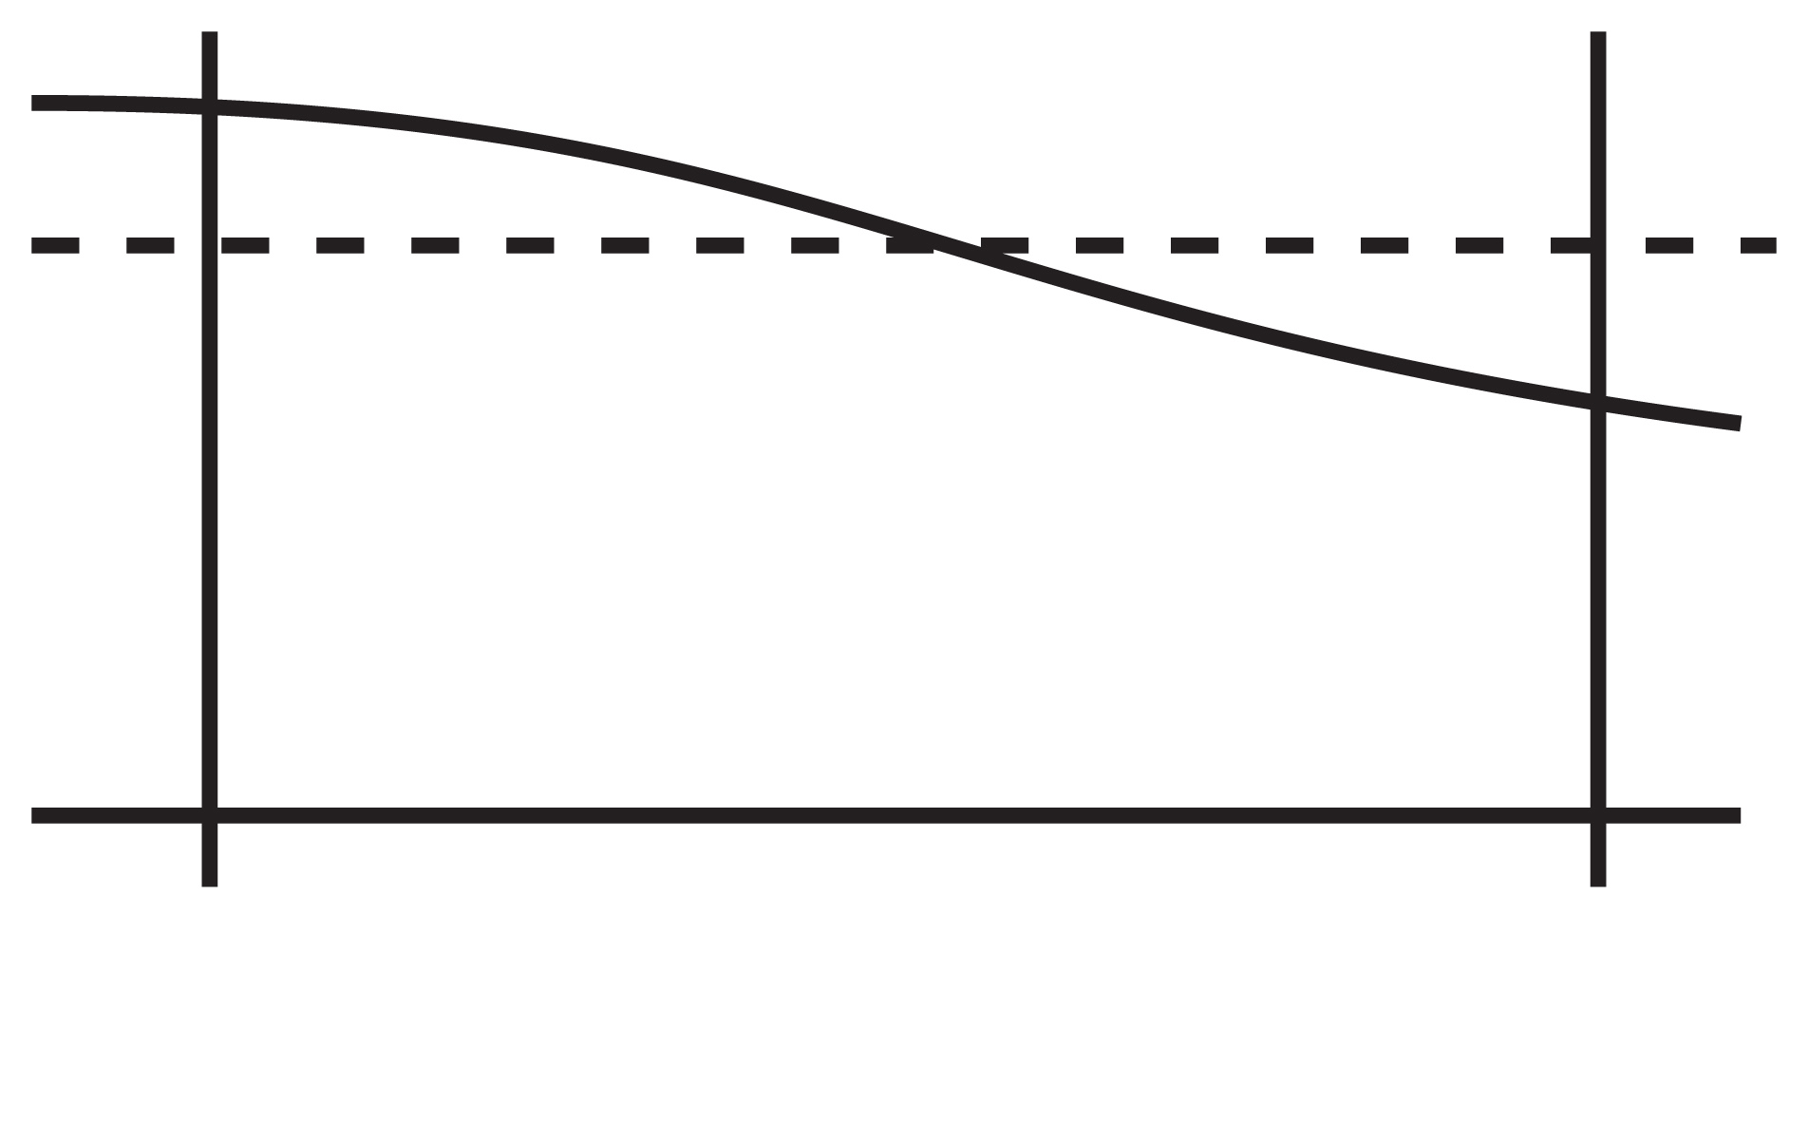
Test of stability: A model
(a) Model structure
(b) Vertical stability
δθ=θ₁−θ₂
h₁>0
h₂>0
θ₁
H_{B}
θ₂
z
y
Cool Warm
(c) Zonal velocity distribution
What is the value of U gradient that renders the cross-equatorial flow inertially unstable?

Slide 66
Tomas, Holton & Webster (2000)

Slide 67

assume
eigenvalues
For inertial instability either the cross- equatorial shear is very large or the vertical stability is low
conditional

Slide 68

East Pacific Ocean
To the south of the equator, there is a substantial inversion but north of the equator, the atmosphere is neutral or unstable. Thus the system is inertially unstable for any shear! (Toma & Webster 2010).
Ditto: South Indian Ocean and East North Atlantic.

Slide 69


What about the NIO in summer?
WIO is a region of extreme subsidence with a well mixed boundary layer capped by a of 4-5 K inversion

Slide 70
Given the stable boundary layer, the linear criterion for inertial instability demands a 50 m/s latitudinal shear over 10 deg latitude for the summer Asian monsoon flow to be inertially unstable
U
25 m/s
-25 m/s
5S
5N

Slide 71
Stability summary in the North Indian Ocean
  North Indian Ocean is inertially unstable due principally to the strong subsidence about the diverging cross-equatorial flow.
  Stable cap does not allow linear stability criterion to be met.
  Major instability resides at time scale much longer than inertial at 20-40 day time scale. Scales determined by thermodynamical considerations (?) although aided by the strong subsidence during the MJO destabilization period??
  Great mysteries in the NIO!

Slide 72

DOES INERTIAL STABILITY IN IO IMPACT FOR ISO FORMATION?
Three phases of ISO:
Destabilization
Convective
Restoring
Involve thermodynamics, clouds, oceans to set time scales
Stephens et al (2004) J.Clim
Wang et al (2005) GRL

Slide 73
(I) DESTABILIZATION PHASE
Strong subsidence
Strong surface heating SST increasing
Upper cooling, lower heating
Trade Cu, Cumulus humulis mixing
Build up of CAPE

Slide 74
(II) CONVECTIVE PHASE
Release of CAPE with deep convection
Projection onto equatorial modes (coupled or uncoupled??)
Stronger winds
Cooling of ocean

Slide 75
(III) RESTORING PHASE
Mode propagation
Stratus phase
Upper level heating
SST starts to increase

Slide 76
DYNAMICAL ADDITION TO SIMPLE THEORY
Unique inertially stability of the WIO region may allow time scale of destabilization phase to be prolonged. Build up CAPE and etc

Slide 77
EFFORTS AT PREDICTING THE ISO
In models, why do strong ISO signals tend to dissipate more rapidly than the observed time scale of the phenomenon? We consider serial runs of the ECMWF model
Are their empirical methods to avoid the signal collapse. We consider a empirical model that avoids signal collapse
Can we use these techniques to statistically correct numerical models? We show and attempt to do so.
How well do couple ocean-atmosphere models do now in predicting the ISO? We look at CFSV2.

Slide 78


Experiment sets using coupled Ocean-atmosphere models
Use ECMWF climate model run for
30 day forecasts on 45 successive
days in ensemble mode (5/day)
Successive daily integration through
all phases of ISO life cycle
Three cases:
o Winter: TOGA COARE, 1992/93
o Summer: May/June 2002 and 2004
OLR variability through summer case
Skill of the Model?
Source of Errors?
Experiments with a Full Ocean and a Mixed-Layer Ocean Model
Notes:
We have used the ECMWF coupled O/A operational climate model in three cases where the model is run -15 days to +15 days about strong summer and winter ISO events.
Model is initialized each successive day for 30 days
Integration continued for 30 days and run in ensemble mode (5 members)
Aim is determine when and where errors grow and why the ISO signal lost.

Slide 79



Results of the Coupled Ocean-Atmosphere Simulations
Agudelo et al. 2006, 2008
ISO max: EIO
successive
ensemble
means
Where do the errors come from that destroy the strong intraseasonal
signal?
verification
(observations)
Notes:
Results of the second summer experiment. 200mb u-component south of India. Rectangle indicates active period of the monsoon. Different colors indicate different ensemble members. Black line: observations.
Bottom LH panel: Growth of errors each day of integrations. Note error growth monotonic in time.
Bottom RH panel: Errors relative to observations . Note maximum errors occur at time of maximum ISO (convective) activity.

Slide 80


Regional Analysis: Coupled Ocean-Atmosphere Model
Agudelo et al. 2006, 2008
Equatorial Indian Ocean
Bay of Bengal
Central India
Notes:
The two types of error growth (defined last slide) for three areas.

Slide 81

Forecasting Skill and Predictability
200 mb Zonal Winds
Forecast Skill is relatively good before Day 8
OLR
Forecasts are better for circulation variables than convection related ones
Notes:
Comparison of skill (error growth) for circulation versus thermodynamical aspects (OLR-convection) of the model response. Error growth in convection far larger than dynamical quanitities

Slide 82

Forecasting Skill and Predictability
Amplitude of the ISO considerably decreases with the forecasting lead time
Notes:
Error growth as function of time: summary of results:
Decrease of ISO amplitude with forecasting lead time.

Slide 83

Joint PDF: 200 mb Zonal Winds
Indo-West Pacific Basin
Notes:
Evolution of errors of dynamical fields with time. Note broad error growth across spectrum of response

Slide 84

Joint PDF: OLR
Indo-West Pacific Basin
Notes:
Ditto with OLR/convection. Error grows more rapidly and are broader. Little resemblance between forecast and relaity.

Slide 85
Non-Parametric Skill Measures
Success Rate (%)
4 different “areas”
Mutual Information
Joint Entropy

Slide 86

Non-Parametric Skill Measures
Low
Mid-Low
Mid-High
High
200mb Zonal Winds
Joint Entropy
Success Rate
Mutual Information
OLR
Notes:
Non-skill measure parametric measures show rapid deterioration of convective forecasts

Slide 87

Where do the errors come from?
Day 1 Errors
Notes:
These are the RMS error for the first day of the integrations. The remarkably coincide with the convective region throughout the whole globe.

Slide 88

Where do the errors come from?
Day 1 Errors
Notes:
These are the RMS error for the first day of the integrations. The remarkably coincide with the convective region throughout the whole globe.

Slide 89
Where do the errors come from?
Day 1 Errors
Notes:
These are the RMS error for the first day of the integrations. The remarkably coincide with the convective region throughout the whole globe.

Slide 90

Where do the errors come from?
Day 2 Errors
Notes:
Errors in day 2 have dispersed (and probably advected) from that region.

Slide 91

Where do the errors come from?
Day 3 Errors
Notes:
Continue…

Slide 92

Where do the errors come from?
Day 4 Errors

Slide 93

Where do the errors come from?
Day 5 Errors
Errors rapidly grow in the regions of maximum convection

Slide 94
(ii) Empirical Prediction
Is it possible to use an empirical regression model to forecast ISO
Trick will be to avoid contamination of high frequency of the slow ISO mode.
We develop a “banded wavelet model” Webster & Hoyos 2004)

Slide 95


Choose Predictors
OLR Field Predictors
Sea-level pressure
Tropical Easterly Jet Index
Central India
Central India
Central IO
Surface Wind Predictors
Upper-tropospheric predictors
Somali Jet Intensity
U, V-comp
200mb U-comp
U-comp
Notes:
We use the phenomenology of the MISO to select the predictors…all the
How robust the predictors are.
Predictors covariate with predictand.

Slide 96

Composites of Predictors
Predictors covariate
with predictand.
Notes:
Relative to Central India Precipitation, all the
How robust the predictors are.
Predictors covariate with predictand.

Slide 97
Statistical Scheme: Wavelet Banding
Statistical scheme uses wavelets to determine spectral structure of predictand.
Based on the definition of the bands in the
predictand, the predictors are also banded identically
Webster and Hoyos (BAMS: November 2004)
Notes:
The empirical scheme is based on the spectrum of the predictand.
The dominant modes are identified and the predictor is spectrally “separated” by filtering. The same with all predictors.
This is the scheme that we use with ECMWF model.
Called the Slow Manifold Model
Important that the predictors are physically based.

Slide 98


20-day forecasts for Central India
2004
Notes:
Examples of the empirical scheme for forecasting Central India rainfall.
Black observations: Red, 20-day forecasts
Results for central India show reasonable skill (R=0.8 at 20 days)

Slide 99

Comparison of three other Bayesian schemes (ANN, MARS, LIN) with the WB technique.
Same predictors used in each

Slide 100
Can we use lessons used in empirical modeling to improve
NWP simulation/predictions of ISO events?
Some success has been achieved using the wavelet-banding technique (Webster & Hoyos 2004) which “protects” ISO variability (the slow manifold) from the errors of high frequency errors.
Can these techniques be applied to climate modeling?
We adapt the wavelet banding method (W&H) to the ECMWF operational climate model
We show results of real-time forecasts and also results from Korean general circulation model
Amplitude of ISO variability is maintained and predictions are improved.

Slide 101

Modifying NWP by Statistics: “Slow Manifold Modeling” of Intraseasonal Variability: A New Approach
Modeling Schema
Hypothesis:
Separation of convective noise
and slow manifold intraseasonal
variability will increase 20-40
day predictability
Strategy:
Control upscale destructive
influence of convective
parameterization error by
adding a filter in the integration.
Scale separation similar to the
“wavelet banding” scheme of
Webster and Hoyos (2004)
T. N. Krishnamurti el al. (90’s)
Notes:
(1) Intraseasonal variability comes and goes in models. One has to ask the question of whether the appearance of intraseasonal variability is merely another example of a fleeting apparition or whether small changes in a model really make a difference. It is difficult to contemplate that the existence, morphology, morbidity and mortality of the MJO and Monsoon Intraseasonal variability (which are so regular in nature) in a general circulation model depends on a particular the choice of convective parameterization
(2) How can one include the real signal of convective heating but eliminate the random errors which we have shown to be so destructive to prediction?
(3) We have eliminated the impact of high frequency random errors in empirical forecasting. The question is: could we use the same techniques in numerical modeling??
(4) We choose a scheme that averages temporally the initial conditions. Averaged field is advanced by one day and a new state defined including the new state. The scheme is advanced into forecast territory for 30 days
(5) Here the averaging period is 7 days. Have done for 3 and 5. Find 5 days optimal.
(6) Note that this is NOT merely averaging but a dynamic process that eliminates random errors in convective paramterization.
System could be fully operational!!!

Slide 102

Slow Manifold Results: ISO Activity (MJJAS)
6-Year Integrations
Kim et al 2008
Notes:
Kim of Korea has shown that the slow manifold technique replicates the spectra of observations. Note that “control” is integrations (one year) without averaging or, essentially, wavelet banding. Kim used n=3. Note similarity between (a) and ©.

Slide 103

Slow Manifold Results: ISO Activity (MJJAS)
OBS
ISO amplitude is greatly improved using the Slow Manifold Scheme
CTRL
SMS
Kim et al 2008
Notes:
Amplitude of ISO much closer to observations with SM scheme.

Slide 104

Comparison of Slow Manifold Model with coupled climate model
Kim et al 2008
30-day global
numerical forecasts
Slow Manifold technique provides more accurate longer term prediction
Notes:
Forecasts using the SM technique in the ECMWF model. Note the similarity of the green curve (SM) with the observations (black). System does far better in time of max ISO (max u-300mb).

Slide 105

200 Zonal WINDS
ECMWF-CM
SMM (5)
Notes:
Comparison of (a) CDC 200mb winds obs, (b) ECMWF model and (c) ECMWF model with slow manifold technique.
Upper panels: Time-longitude, Lower panels Latitude -time.
SM model does far better than control.

Slide 106

CDC OLR
EC-CM OLR
SMM (5) OLR
Notes:
Ditto but for OLR

Slide 107

Slow Manifold Results: Different Averaging Scale (N)
N=3
N=5
N=7
Notes:
Changes with respect to choice of N (number of days of averaging).

Slide 108
Summary
ECMWF Model: Errors rapidly grow in the regions of maximum convection
Error higher during ISO convective phase
Error (Convective V.) > Error (Circulation V.)
Error growth so rapid from small scale convection that variability at longer scales is eroded (good skill out to 8-days )
Slow Manifold Modeling (SMM): Separation of convective noise and slow manifold intraseasonal variability
SMM improves forecasts intraseasonal variability with considerable skill
Notes:
Until models can (if ever) model convection completely and accurately, empirical-NWP mixes are the best hope for improving accuracy of forecast of ISO.

Slide 109

Prediction skill for summer MJO (Wheeler and Hendon RMM index)
Phase-space evolution of RMMs by MJO initial phases
Strong MJO
NCEP CFSv2
OBS
Fig: Phase–space evolution of forecast and observed RMM1 and 2 composited for initial dates with Strong MJO. Evolution is shown for 20 days and dots are 5 days apart.
Over the Indian Ocean:
Slower phase speed of MJO in the model.
Model MJO amplitude decay faster than OBS.
Evolution

Slide 110


Prediction skill for summer MJO (Wheeler and Hendon RMM index)
Phase-space evolution of RMMs by MJO initial phases
NCEP CFSv2
OBS
Moderate MJO
Weak MJO

Slide 111
SOME TAKE-HOME MESSAGES
We need to decide on the scales of importance in the ISO. This (to me) is a necessary condition to understand the ISO
Do we need to understand the ISO in order to predict it?
A resounding YES:
(i) We are not model geographers but physicists. Confidence in a model requires an understanding of the physics. Note Feynman (“the easiest person to fool is yourself”)
(ii) Understanding determines the type of model you should use and how to correct it statistically
(3) Need to revisit the forced and free convective modes. I think we are hung between the two at the moment. Simple and very basic arguments help here (e.g., basic scaling)
(4) Instabilities and what forces the convective modes. Still a great problem after 50 years BUT progress (I think).
(5) Still a long way to go on the ISO

